Slide 1
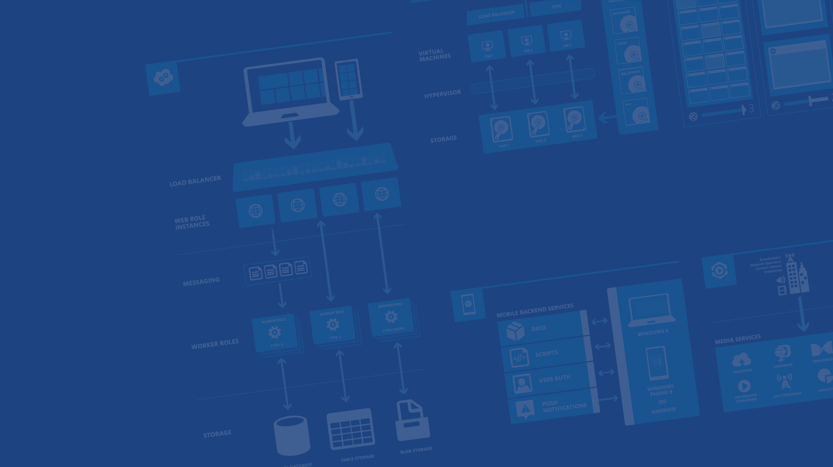
Azure Data Overview
Presenter Name
Position or role
Microsoft Azure

Slide 2

Microsoft Azure Data Platform
SQL Database
SQL on IaaS
DocumentDB
Search
HDInsight
MongoDB, MySQL, Oracle, Cassandra, Neo4j and more
Notes:
The Azure data Platform is HUGE and growing. This session will have to be brief about some of this content and make a few deep dives here and there.

Slide 3
SQL Database
Why (at least) two offerings of SQL in Azure?
SQL IaaS

Slide 4
SQL Database
Fully managed “as a Service”
Enterprise-ready with automatic support for HA, DR, Backups, replication and more
Can scale out elastically using ElasticScale
…
SQL IaaS
Choice of a variety of DB engines (SQL Server, Oracle, MySql)
All the features of native DB
Windows authentication available (requires VM to be joined to on-premises domain)
Larger database sizes possible (16TB)
…

Slide 5
SQL Database
Applications that need elastic scale and/or reduced overhead.
Customer does not want to add additional IT resources for support and maintenance.
Avoiding CAPEX and OPEX.
Built-in & programmatic DBA-like features.
SQL IaaS
Existing applications which requires full box product functionality.
Customer has ecosystem of IT resources for support and maintenance.
Removing CAPEX.
Full SQL Server functionality.

Slide 6
Microsoft Azure Data Platform
SQL Database
SQL on IaaS
DocumentDB
Search
HDInsight
MongoDB, MySQL, Oracle, Cassandra, Neo4j and more
Notes:
Now let’s focus on Microsoft Azure SQL Database the PaaS service!

Slide 7
Microsoft Azure SQL Database

Slide 8

Microsoft Relational Storage Options
A Continuous offering
Physical
Virtual
IaaS
PaaS
From private to public Cloud
Notes:
Slide Objectives:
Show Microsoft’ continuous Private to Public Cloud Offering, but this presentation will focus on Microsoft’s relational database PaaS offering.
Transition:
Microsoft provides a continuous solution from private cloud to the public cloud. No matter where you are on your technology roadmap we have a solution to fit your needs.
We are a trusted advisor and platform in the traditional enterprise and ISV space with new IaaS offerings that making it easier to bring this same level of trust and ease of use to the public cloud. However, Microsoft Azure SQL Database extends SQL Server capabilities to the cloud by offering SQL Server as a relational database service.
Speaking Points:
SQL Database provides SQL Server as a relational service.

Slide 9
Microsoft Azure SQL Database
Architecture
Starting with the basics

Slide 10
A Server is not a machine
SQL Server
Machine
(Physical/VM)
Azure
SQL Database Server
TDS Endpoint
Notes:
Slide Objectives:
Understand that while there are physical SQL Server boxes behind the scenes, when connecting to SQL Database, you are not connecting to a physical server, but to a TDS endpoint.
Transition:
The key to understanding SQL Database is understanding while SQL Database is SQL Server, we do not interact with them in the same physical manner.
Speaking Points:
In an on-premises environment, we typically have physical access to the actual SQL Server server.
In Microsoft Azure, we do not have physical access to the actual server.
Notes:
It is important that the attendee understands that it IS INDEED SQL Server at the platform layer. There are physical boxes running SQL Server 2012 Enterprise Edition. However, due to the nature of the Azure environment to provide the high-availability and scalability necessary, access to the physical boxes is currently not supported.

Slide 11
SQL Server database technology “as a Service”
Fully Managed
Enterprise-ready with automatic support for HA, DR, Backups, replication and more
SQL Database – The Basics
Notes:
Slide Objectives:
Understand the overall concepts and benefits of SQL Database
Transition:
Let’s clear up any confusion and look at the basics of what SQL Database really is and some of its benefits.
Speaking Points:
The same great SQL Server database technology that you know, love, and use on-premises provided as a service
Enterprise-ready
Automatic support for High-Availability
Designed to scale on-demand to provide the same great elasticity
Notes:
High-availability – 3 copies of the database free for the cost of the one database. Always in sync. The cost to do this on-premises isn’t cheap. This is FREE in SQL Database.

Slide 12
Scale out with ElasticScale
Built-in regional database replicas for additional protection
Uptime SLA of 99.99%
SQL Database – The Basics
Notes:
Slide Objectives:
Understand the overall concepts and benefits of SQL Database
Transition:
Let’s clear up any confusion and look at the basics of what SQL Database really is and some of its benefits.
Speaking Points:
The same great SQL Server database technology that you know, love, and use on-premises provided as a service
Enterprise-ready
Automatic support for High-Availability
Designed to scale on-demand to provide the same great elasticity
Notes:
High-availability – 3 copies of the database free for the cost of the one database. Always in sync. The cost to do this on-premises isn’t cheap. This is FREE in SQL Database.

Slide 13
How It Works – Architecture of the Service
Client Layer
PHP
SQL Server
Applications
and Tools
WCF Data Services
Applications communicate directly with SQL Database using TDS.
ODBC
ADO.NET
Tabular Data Stream (TDS)
Notes:
Slide Objectives:
To understand the actual architecture that provides the enterprise-ready SQL Database service.
Transition:
Developers have spent years working with their technology of choice, and Microsoft wanted to ensure that the technologies and tools you use today will continue to work with SQL Database without learning a whole new set of technologies.
Speaking Points:
Familiar technology and tools
Similar architecture as that of on-premises
Additional layer providing server and database partitioning, client connection routing, and billing.
Same great SQL Server technology on the backend.
Additional services (SQL Database Fabric) to ensure SLAs are met and to ensure optimum performance.
Notes:
Client - The client layer resides closest to your application, and is used by your application to communicate directly with SQL Database. The client layer can reside on-premise in your datacenter or be hosted in Microsoft Azure. Because SQL Database provides the same tabular data stream (TDS) interface as SQL Server, you can use familiar tools and libraries to build client applications for data that is in the cloud.
Services - The services layer functions as a gateway between the client layer and the platform layer, where the data resides. The services layer provides three functions: provisioning, billing and metering, and connection routing.
The services layer provisions the databases that you specify with your Microsoft Azure platform account. The billing and metering aspect of the services layer enables multi-tenant support by providing monitoring and billing for database usage based on individual Microsoft Azure platform accounts. SQL Database is built on a scalable platform involving numerous physical servers; this layer handles all the connections routing between your application and the physical servers where your data resides.
Platform - The platform layer includes the physical servers and services that support the services layer. The platform layer consists of many instances of SQL Server, each of which is managed by the SQL Database fabric.
The SQL Database fabric is a distributed computing system composed of tightly integrated networks, servers, and storage. It enables automatic failover, load balancing, and automatic replication between physical servers.
Management services monitor the health of individual servers and enable automated installation of service upgrades and software patches.
Infrastructure - The infrastructure layer represents the IT administration of the physical hardware and operating systems that support the services layer.

Slide 14
How It Works – Architecture of the Service
Client Layer
PHP
SQL Server
Applications
and Tools
WCF Data Services
ODBC
ADO.NET
Tabular Data Stream (TDS)
TDS+SSL
Gateway between Client layer and Platform layer.
Services Layer
Provisioning
Billing and Metering
Connection Routing
Notes:
Slide Objectives:
To understand the actual architecture that provides the enterprise-ready SQL Database service.
Transition:
Developers have spent years working with their technology of choice, and Microsoft wanted to ensure that the technologies and tools you use today will continue to work with SQL Database without learning a whole new set of technologies.
Speaking Points:
Familiar technology and tools
Similar architecture as that of on-premises
Additional layer providing server and database partitioning, client connection routing, and billing.
Same great SQL Server technology on the backend.
Additional services (SQL Database Fabric) to ensure SLAs are met and to ensure optimum performance.
Notes:
Client - The client layer resides closest to your application, and is used by your application to communicate directly with SQL Database. The client layer can reside on-premise in your datacenter or be hosted in Microsoft Azure. Because SQL Database provides the same tabular data stream (TDS) interface as SQL Server, you can use familiar tools and libraries to build client applications for data that is in the cloud.
Services - The services layer functions as a gateway between the client layer and the platform layer, where the data resides. The services layer provides three functions: provisioning, billing and metering, and connection routing.
The services layer provisions the databases that you specify with your Microsoft Azure platform account. The billing and metering aspect of the services layer enables multi-tenant support by providing monitoring and billing for database usage based on individual Microsoft Azure platform accounts. SQL Database is built on a scalable platform involving numerous physical servers; this layer handles all the connections routing between your application and the physical servers where your data resides.
Platform - The platform layer includes the physical servers and services that support the services layer. The platform layer consists of many instances of SQL Server, each of which is managed by the SQL Database fabric.
The SQL Database fabric is a distributed computing system composed of tightly integrated networks, servers, and storage. It enables automatic failover, load balancing, and automatic replication between physical servers.
Management services monitor the health of individual servers and enable automated installation of service upgrades and software patches.
Infrastructure - The infrastructure layer represents the IT administration of the physical hardware and operating systems that support the services layer.

Slide 15
How It Works – Architecture of the Service
Client Layer
PHP
SQL Server
Applications
and Tools
WCF Data Services
ODBC
ADO.NET
Tabular Data Stream (TDS)
TDS+SSL
Services Layer
Provisioning
Billing and Metering
Connection Routing
Includes physical servicers and services that support the Services layer.
Platform Layer
SQL Server
SQL Database Fabric
Management Services
Notes:
Slide Objectives:
To understand the actual architecture that provides the enterprise-ready SQL Database service.
Transition:
Developers have spent years working with their technology of choice, and Microsoft wanted to ensure that the technologies and tools you use today will continue to work with SQL Database without learning a whole new set of technologies.
Speaking Points:
Familiar technology and tools
Similar architecture as that of on-premises
Additional layer providing server and database partitioning, client connection routing, and billing.
Same great SQL Server technology on the backend.
Additional services (SQL Database Fabric) to ensure SLAs are met and to ensure optimum performance.
Notes:
Client - The client layer resides closest to your application, and is used by your application to communicate directly with SQL Database. The client layer can reside on-premise in your datacenter or be hosted in Microsoft Azure. Because SQL Database provides the same tabular data stream (TDS) interface as SQL Server, you can use familiar tools and libraries to build client applications for data that is in the cloud.
Services - The services layer functions as a gateway between the client layer and the platform layer, where the data resides. The services layer provides three functions: provisioning, billing and metering, and connection routing.
The services layer provisions the databases that you specify with your Microsoft Azure platform account. The billing and metering aspect of the services layer enables multi-tenant support by providing monitoring and billing for database usage based on individual Microsoft Azure platform accounts. SQL Database is built on a scalable platform involving numerous physical servers; this layer handles all the connections routing between your application and the physical servers where your data resides.
Platform - The platform layer includes the physical servers and services that support the services layer. The platform layer consists of many instances of SQL Server, each of which is managed by the SQL Database fabric.
The SQL Database fabric is a distributed computing system composed of tightly integrated networks, servers, and storage. It enables automatic failover, load balancing, and automatic replication between physical servers.
Management services monitor the health of individual servers and enable automated installation of service upgrades and software patches.
Infrastructure - The infrastructure layer represents the IT administration of the physical hardware and operating systems that support the services layer.

Slide 16
How It Works – Architecture of the Service
Client Layer
PHP
SQL Server
Applications
and Tools
WCF Data Services
ODBC
ADO.NET
Tabular Data Stream (TDS)
TDS+SSL
Services Layer
Provisioning
Billing and Metering
Connection Routing
Platform Layer
SQL Server
SQL Database Fabric
Administration of the physical HW and OS.
Management Services
Infrastructure Layer
Notes:
Slide Objectives:
To understand the actual architecture that provides the enterprise-ready SQL Database service.
Transition:
Developers have spent years working with their technology of choice, and Microsoft wanted to ensure that the technologies and tools you use today will continue to work with SQL Database without learning a whole new set of technologies.
Speaking Points:
Familiar technology and tools
Similar architecture as that of on-premises
Additional layer providing server and database partitioning, client connection routing, and billing.
Same great SQL Server technology on the backend.
Additional services (SQL Database Fabric) to ensure SLAs are met and to ensure optimum performance.
Notes:
Client - The client layer resides closest to your application, and is used by your application to communicate directly with SQL Database. The client layer can reside on-premise in your datacenter or be hosted in Microsoft Azure. Because SQL Database provides the same tabular data stream (TDS) interface as SQL Server, you can use familiar tools and libraries to build client applications for data that is in the cloud.
Services - The services layer functions as a gateway between the client layer and the platform layer, where the data resides. The services layer provides three functions: provisioning, billing and metering, and connection routing.
The services layer provisions the databases that you specify with your Microsoft Azure platform account. The billing and metering aspect of the services layer enables multi-tenant support by providing monitoring and billing for database usage based on individual Microsoft Azure platform accounts. SQL Database is built on a scalable platform involving numerous physical servers; this layer handles all the connections routing between your application and the physical servers where your data resides.
Platform - The platform layer includes the physical servers and services that support the services layer. The platform layer consists of many instances of SQL Server, each of which is managed by the SQL Database fabric.
The SQL Database fabric is a distributed computing system composed of tightly integrated networks, servers, and storage. It enables automatic failover, load balancing, and automatic replication between physical servers.
Management services monitor the health of individual servers and enable automated installation of service upgrades and software patches.
Infrastructure - The infrastructure layer represents the IT administration of the physical hardware and operating systems that support the services layer.

Slide 17
How It Works – Architecture of the Service
Client Layer
PHP
SQL Server
Applications
and Tools
WCF Data Services
ODBC
ADO.NET
Tabular Data Stream (TDS)
TDS+SSL
Services Layer
Provisioning
Billing and Metering
Microsoft Azure SQL Database
PaaS
Connection Routing
Platform Layer
SQL Server
SQL Database Fabric
Management Services
Infrastructure Layer
Notes:
Slide Objectives:
To understand the actual architecture that provides the enterprise-ready SQL Database service.
Transition:
Developers have spent years working with their technology of choice, and Microsoft wanted to ensure that the technologies and tools you use today will continue to work with SQL Database without learning a whole new set of technologies.
Speaking Points:
Familiar technology and tools
Similar architecture as that of on-premises
Additional layer providing server and database partitioning, client connection routing, and billing.
Same great SQL Server technology on the backend.
Additional services (SQL Database Fabric) to ensure SLAs are met and to ensure optimum performance.
Notes:
Client - The client layer resides closest to your application, and is used by your application to communicate directly with SQL Database. The client layer can reside on-premise in your datacenter or be hosted in Microsoft Azure. Because SQL Database provides the same tabular data stream (TDS) interface as SQL Server, you can use familiar tools and libraries to build client applications for data that is in the cloud.
Services - The services layer functions as a gateway between the client layer and the platform layer, where the data resides. The services layer provides three functions: provisioning, billing and metering, and connection routing.
The services layer provisions the databases that you specify with your Microsoft Azure platform account. The billing and metering aspect of the services layer enables multi-tenant support by providing monitoring and billing for database usage based on individual Microsoft Azure platform accounts. SQL Database is built on a scalable platform involving numerous physical servers; this layer handles all the connections routing between your application and the physical servers where your data resides.
Platform - The platform layer includes the physical servers and services that support the services layer. The platform layer consists of many instances of SQL Server, each of which is managed by the SQL Database fabric.
The SQL Database fabric is a distributed computing system composed of tightly integrated networks, servers, and storage. It enables automatic failover, load balancing, and automatic replication between physical servers.
Management services monitor the health of individual servers and enable automated installation of service upgrades and software patches.
Infrastructure - The infrastructure layer represents the IT administration of the physical hardware and operating systems that support the services layer.

Slide 18
The Service head contains databases
Connect via automatically generated FQDN: {name}.database.windows.net
Initially contains only a master database
SQL Database – Server Definition
Notes:
Slide Objectives:
Show the different methods of provisioning a SQL Database server along with how easy it is. Plus, help the attendees understand what a SQL Database “server” really is.
Transition:
Provisioning an on-premises SQL Server box can be time consuming, costly, and at times, a challenge. With SQL Database, provisioning a “server” is painless, quick, and provisioned in a matter of seconds.
Speaking Points:
Provision servers interactively using the Management Portal
Automate server provisioning using the Microsoft Azure Management API or PowerShell.
Notes:
While the “server” is technically a TDS endpoint, much of the SQL Server process is similar. Administration login credentials are still needed for security, and more importantly defining service access is essential, and required, for maintaining the integrity of your server through firewall rules.

Slide 19
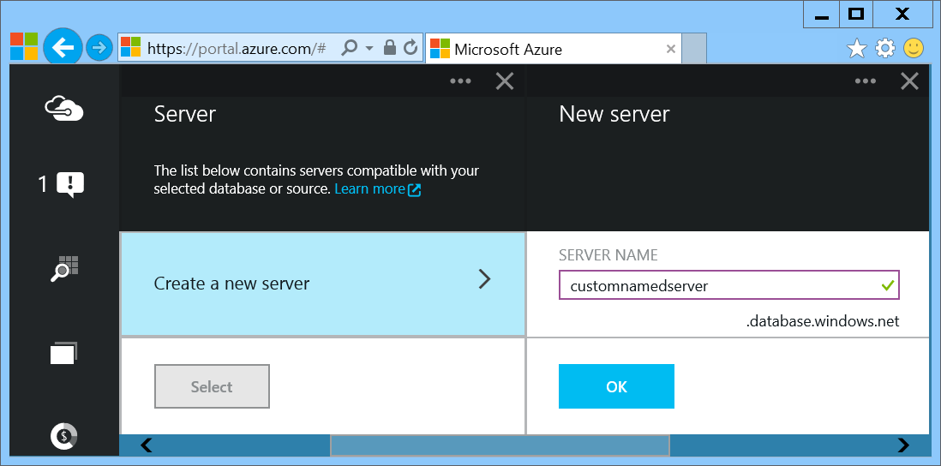
SQL Database – Provision Servers Interactively
In the Preview Management Portal create a SQL Database server
Notes:
Important: In the Preview Management Portal you are able to create a custom server FQDN! In the Management Portal that name is randomized.
Slide Objectives:
Show the different methods of provisioning a SQL Database server along with how easy it is. Plus, help the attendees understand what a SQL Database “server” really is.
In the Preview Portal you can select the name of the server you create!
Transition:
Provisioning an on-premises SQL Server box can be time consuming, costly, and at times, a challenge. With SQL Database, provisioning a “server” is painless, quick, and provisioned in a matter of seconds.
Speaking Points:
Provision servers interactively using the Management Portal
Automate server provisioning using the Microsoft Azure Management API or PowerShell.
Notes:
While the “server” is technically a TDS endpoint, much of the SQL Server process is similar. Administration login credentials are still needed for security, and more importantly defining service access is essential, and required, for maintaining the integrity of your server through firewall rules.

Slide 20
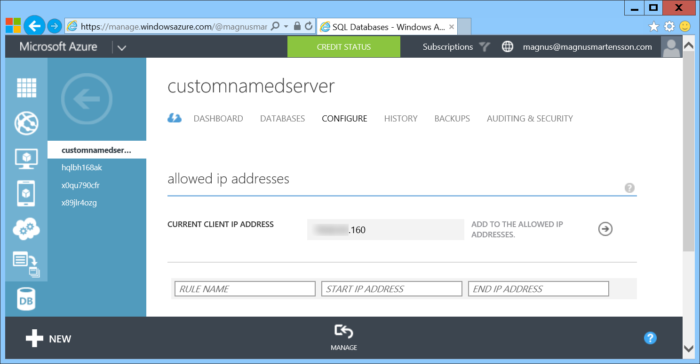
SQL Database – Provision Servers Interactively
In the Management Portal add firewall rules
Notes:
Slide Objectives:
Show the different methods of provisioning a SQL Database server along with how easy it is. Plus, help the attendees understand what a SQL Database “server” really is.
Transition:
Provisioning an on-premises SQL Server box can be time consuming, costly, and at times, a challenge. With SQL Database, provisioning a “server” is painless, quick, and provisioned in a matter of seconds.
Speaking Points:
Provision servers interactively using the Management Portal
Automate server provisioning using the Microsoft Azure Management API or PowerShell.
Notes:
While the “server” is technically a TDS endpoint, much of the SQL Server process is similar. Administration login credentials are still needed for security, and more importantly defining service access is essential, and required, for maintaining the integrity of your server through firewall rules.

Slide 21
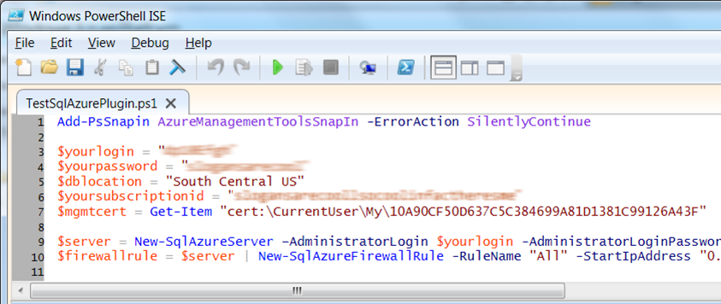
SQL Database – Automate Server Provisioning
Microsoft Azure Platform PowerShell cmdlets
Notes:
Slide Objectives:
Show the different methods of provisioning a SQL Database server along with how easy it is. Plus, help the attendees understand what a SQL Database “server” really is.
Transition:
Provisioning an on-premises SQL Server box can be time consuming, costly, and at times, a challenge. With SQL Database, provisioning a “server” is painless, quick, and provisioned in a matter of seconds.
Speaking Points:
Provision servers interactively using the Management Portal
Automate server provisioning using the Microsoft Azure Management API or PowerShell.
Notes:
While the “server” is technically a TDS endpoint, much of the SQL Server process is similar. Administration login credentials are still needed for security, and more importantly defining service access is essential, and required, for maintaining the integrity of your server through firewall rules.

Slide 22
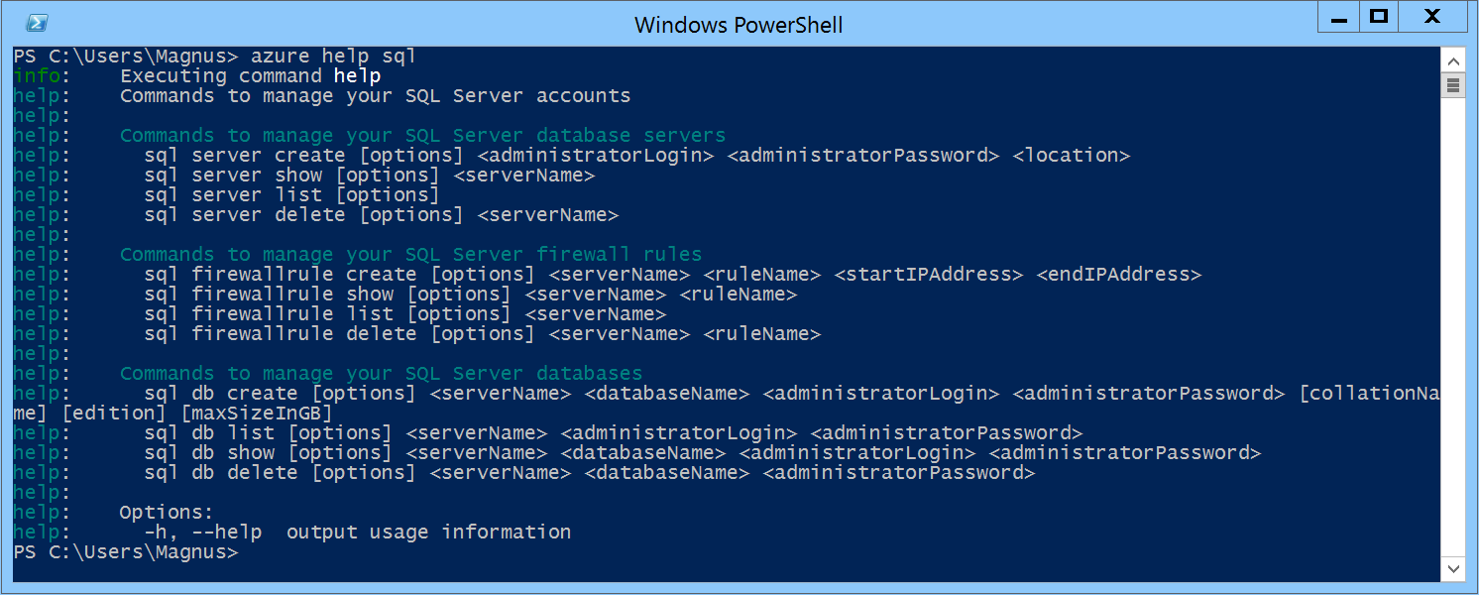
SQL Database – Automate Server Provisioning
Azure Cross-Platform Command-Line Interface (xplat-cli)
Notes:
Slide Objectives:
Show the different methods of provisioning a SQL Database server along with how easy it is. Plus, help the attendees understand what a SQL Database “server” really is.
Transition:
Provisioning an on-premises SQL Server box can be time consuming, costly, and at times, a challenge. With SQL Database, provisioning a “server” is painless, quick, and provisioned in a matter of seconds.
Speaking Points:
Automate server provisioning using the Microsoft Azure Management API or PowerShell or xplat-cli.

Slide 23
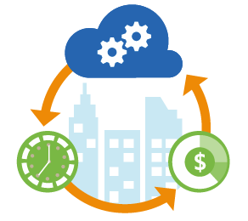
SQL Database – Automation always pays off
http://bit.ly/azureAutomation

Slide 24
Creating A SQL Database Server
Demo
Notes:
Use Azure Portal (Ibiza) to create a new database server

Slide 25
Selecting the right SQL Database edition
Service Tier | Performance Level | Common App Pattern | Performance |  |  | Business Continuity
 |  |  | Max DB Size | Trans. Perf. Objective | DTU | PITR | DR / GEO-Rep
Basic | Basic | Small DB, SQL opp | 2 GB | Reliability / Hr. | 5 | 7 Days | DB Copy + Manual Export
Standard | S0 S1 S2 | Wrkgp/cloud app, multiple concurrent operations | 250 GB | Reliability / Min. | 10 20 50 | 14 Days | DB Copy + Manual Export
Premium | P1 P2 P3 | Mission Critical, High volume, Many concurrent Users | 500 GB | Reliability / sec. | 100 200 800 | 35 Days | Active Geo-replication
This information is subject to change over time.
Notes:
Slide Objectives:
Highlight what’s new in the latest SQL Database service update.
Transition:
In late September a service update was deployed to Microsoft Azure SQL Database that included new functionality.
Speaking Points:
Linked Server – This is a new component for database hybrid solutions spanning on-premises corporate networks and the Microsoft Azure cloud.
Recursive Trigger – Just like SQL Server 2012, the option can be configured via ALTER DATABASE dbname SET RECURSIVE_TRIGGERS ON|OFF
DBCC – The query optimizer uses statistics to estimate the cardinality or number of rows in the query result, which enables the query optimizer to create a high quality query plan.
Firewall Rules – different rules for different databases hosted on the same logical SQL Database server
Notes:

Slide 26
Auto backups, transactional logs every 5 min
Backups in Azure Storage and geo-replicated
Creates a side-by-side copy, non-disruptive
Backups retention policy: 7, 14 or 35 days
Automated export of logical backups for long-term backup protection
Point-in-time restore - “oops recovery”

Slide 27
Available in Basic, Standard and Premium
Built on geo-redundant Azure Storage
Recover to any Azure region
Geo-restore – Emergency data recovery when you need it most
Notes:
Emergency data recovery when you need it most

Slide 28
Opt-in for Standard & Premium databases
Creates a stand-by secondary
Replicate to pre-paired Azure region
Automatic data replication, asynchronous
Opt-in via REST API, PowerShell or Azure Portal
Microsoft-managed, RTO<24h, RPO<1 hr
Standard geo-replication

Slide 29
Self-service activation in Premium
Create up to 4 readable secondaries
Replicate to any Azure region
Automatic data replication, asynchronous
REST API, PowerShell or Azure Portal
RTO<1h, RPO<5m, you choose when to failover
Active geo-replication

Slide 30
Configurable to track & log database activity
Dashboard views in the portal for at-a-glance insights
Pre-defined Power View reports for deep visual analysis on Audit log data
Audit logs reside in your Azure Storage account
Available in Basic, Standard, and Premium
Auditing
Notes:
Gain insight into database events & streamline compliance-related tasks

Slide 31
Create and deploy your database
Demo
Notes:
Use the Preview Management Portal to create a new database.

Slide 32
Transact-SQL
Use Familiar Technologies
(obviously)
Notes:
Slide Objectives:
Point out that 1) The same great technologies that developers use today on-premises works with SQL Database 2) high-level differences between on-premises and SQL Database 3) SQL Database features currently unsupported
Transition:
Creating, managing, and deploying a database in Microsoft Azure SQL Database isn’t difficult. The key is understanding the features that are supported and how SQL Database compares to on-premises SQL Server and the technologies that can be used with SQL Database.
Speaking Points:
The same great technologies that developers use today on-premises works with SQL Database, including developer languages, Frameworks, and Tools. Nothing new to learn!
SQL Server Comparison -> highlight the physical vs. logical administration. Developers and DBAs can now focus on things they love to do and not worry about the physical aspect.
Features unsupported by SQL Database -> Many of the unsupported features are hardware based and thus don’t need to be in SQL Database. Other features, such as encryption, are server-based and become a challenge in solving in a shared-environment.
Notes:
CLR data types ARE supported, SQLCLR is not yet supported.
Backup/Restore: PIT Coming; Import/Export can be used for backup to BLOB storage. Third-party backup products available via RedGate and Enzo.
Data can be stored encrypted but the encryption must be done at the application level.
Native encryption is being looked at.
**Linked Servers and Distributed Queries are now supported, linking a SQL Database instance from an on-premises server. Linking two SQL Database instances is NOT supported.

Slide 33
.NET Framework (C#, Visual Basic, F#): ADO.NET
C / C++: ODBC
Java: Microsoft JDBC provider
PHP: Microsoft PHP provider
Use Familiar Technologies - Languages
Notes:
Slide Objectives:
Point out that 1) The same great technologies that developers use today on-premises works with SQL Database 2) high-level differences between on-premises and SQL Database 3) SQL Database features currently unsupported
Transition:
Creating, managing, and deploying a database in Microsoft Azure SQL Database isn’t difficult. The key is understanding the features that are supported and how SQL Database compares to on-premises SQL Server and the technologies that can be used with SQL Database.
Speaking Points:
The same great technologies that developers use today on-premises works with SQL Database, including developer languages, Frameworks, and Tools. Nothing new to learn!
SQL Server Comparison -> highlight the physical vs. logical administration. Developers and DBAs can now focus on things they love to do and not worry about the physical aspect.
Features unsupported by SQL Database -> Many of the unsupported features are hardware based and thus don’t need to be in SQL Database. Other features, such as encryption, are server-based and become a challenge in solving in a shared-environment.
Notes:
CLR data types ARE supported, SQLCLR is not yet supported.
Backup/Restore: PIT Coming; Import/Export can be used for backup to BLOB storage. Third-party backup products available via RedGate and Enzo.
Data can be stored encrypted but the encryption must be done at the application level.
Native encryption is being looked at.
**Linked Servers and Distributed Queries are now supported, linking a SQL Database instance from an on-premises server. Linking two SQL Database instances is NOT supported.

Slide 34
Odata
Entity Framework
WCF Data Services
Nhibernate (etc.)
Use Familiar Technologies - Frameworks
Notes:
Slide Objectives:
Point out that 1) The same great technologies that developers use today on-premises works with SQL Database 2) high-level differences between on-premises and SQL Database 3) SQL Database features currently unsupported
Transition:
Creating, managing, and deploying a database in Microsoft Azure SQL Database isn’t difficult. The key is understanding the features that are supported and how SQL Database compares to on-premises SQL Server and the technologies that can be used with SQL Database.
Speaking Points:
The same great technologies that developers use today on-premises works with SQL Database, including developer languages, Frameworks, and Tools. Nothing new to learn!
SQL Server Comparison -> highlight the physical vs. logical administration. Developers and DBAs can now focus on things they love to do and not worry about the physical aspect.
Features unsupported by SQL Database -> Many of the unsupported features are hardware based and thus don’t need to be in SQL Database. Other features, such as encryption, are server-based and become a challenge in solving in a shared-environment.
Notes:
CLR data types ARE supported, SQLCLR is not yet supported.
Backup/Restore: PIT Coming; Import/Export can be used for backup to BLOB storage. Third-party backup products available via RedGate and Enzo.
Data can be stored encrypted but the encryption must be done at the application level.
Native encryption is being looked at.
**Linked Servers and Distributed Queries are now supported, linking a SQL Database instance from an on-premises server. Linking two SQL Database instances is NOT supported.

Slide 35
SQL Server Management Studio (>=2008 R2)
SQL Server command-line utilities (SQLCMD, BCP)
CA Erwin® Data Modeler
Embarcadero Technologies DBArtisan®
Use Familiar Technologies - Tools
Notes:
Slide Objectives:
Point out that 1) The same great technologies that developers use today on-premises works with SQL Database 2) high-level differences between on-premises and SQL Database 3) SQL Database features currently unsupported
Transition:
Creating, managing, and deploying a database in Microsoft Azure SQL Database isn’t difficult. The key is understanding the features that are supported and how SQL Database compares to on-premises SQL Server and the technologies that can be used with SQL Database.
Speaking Points:
The same great technologies that developers use today on-premises works with SQL Database, including developer languages, Frameworks, and Tools. Nothing new to learn!
SQL Server Comparison -> highlight the physical vs. logical administration. Developers and DBAs can now focus on things they love to do and not worry about the physical aspect.
Features unsupported by SQL Database -> Many of the unsupported features are hardware based and thus don’t need to be in SQL Database. Other features, such as encryption, are server-based and become a challenge in solving in a shared-environment.
Notes:
CLR data types ARE supported, SQLCLR is not yet supported.
Backup/Restore: PIT Coming; Import/Export can be used for backup to BLOB storage. Third-party backup products available via RedGate and Enzo.
Data can be stored encrypted but the encryption must be done at the application level.
Native encryption is being looked at.
**Linked Servers and Distributed Queries are now supported, linking a SQL Database instance from an on-premises server. Linking two SQL Database instances is NOT supported.

Slide 36
Use command, distributed transactions, distributed views
Service Broker
Common Language Runtime (CLR)
SQL Agent
SQL Profiler
Native Encryption
Unsupported SQL Server Features
Notes:
Slide Objectives:
Point out that 1) The same great technologies that developers use today on-premises works with SQL Database 2) high-level differences between on-premises and SQL Database 3) SQL Database features currently unsupported
Transition:
Creating, managing, and deploying a database in Microsoft Azure SQL Database isn’t difficult. The key is understanding the features that are supported and how SQL Database compares to on-premises SQL Server and the technologies that can be used with SQL Database.
Speaking Points:
The same great technologies that developers use today on-premises works with SQL Database, including developer languages, Frameworks, and Tools. Nothing new to learn!
SQL Server Comparison -> highlight the physical vs. logical administration. Developers and DBAs can now focus on things they love to do and not worry about the physical aspect.
Features unsupported by SQL Database -> Many of the unsupported features are hardware based and thus don’t need to be in SQL Database. Other features, such as encryption, are server-based and become a challenge in solving in a shared-environment.
Notes:
CLR data types ARE supported, SQLCLR is not yet supported.
Backup/Restore: PIT Coming; Import/Export can be used for backup to BLOB storage. Third-party backup products available via RedGate and Enzo.
Data can be stored encrypted but the encryption must be done at the application level.
Native encryption is being looked at.
**Linked Servers and Distributed Queries are now supported, linking a SQL Database instance from an on-premises server. Linking two SQL Database instances is NOT supported.

Slide 37
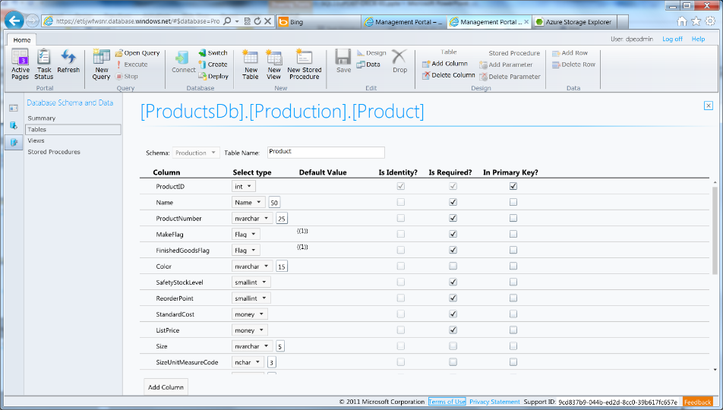
Azure SQL Database Management Portal
Web designers for tables, views, stored procs
Interactive query editing and execution
Notes:
Slide Objectives:
Highlight the set of tools for developers when interacting with Microsoft Azure SQL Database.
Transition:
Transition statement(s) to setup the slide
Speaking Points:
SQL Database Management Portal -> Cross Browser, Unified Management Experience
SQL Server Data Tools -> Integrated Database Design Environment, Table Designer, Debugging, T-SQL Editor
Notes:
IntelliSense in T-SQL Editor
SQL Server Data Tools
Strive to make it consistent as possible
Intersection with the cloud
Bridging you to the new cloud world
Consistency to the new developer experience
Consistency with the new cloud model

Slide 38
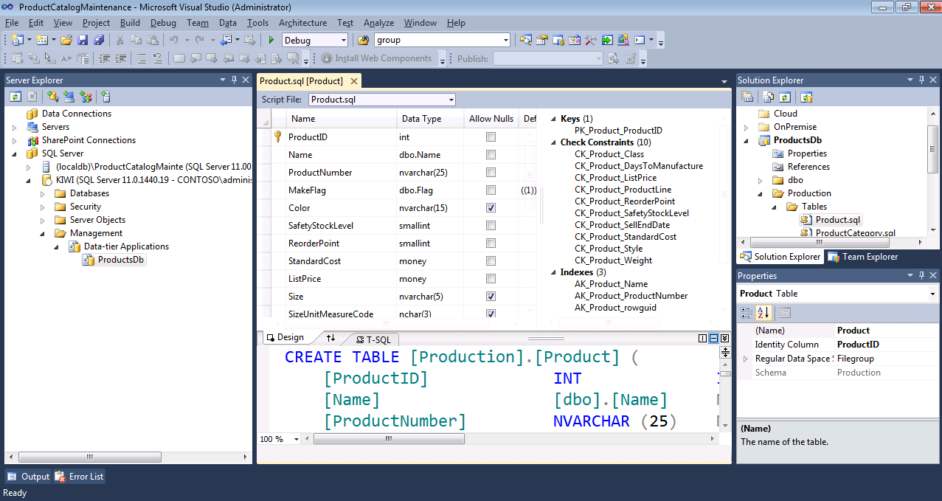
Includes modern designers and projects with declarative, model-driven development
Develop and test in both connected and disconnected states
Visual Studio IDE for database development
Notes:
Slide Objectives:
Highlight the set of tools for developers when interacting with Microsoft Azure SQL Database.
Transition:
Transition statement(s) to setup the slide
Speaking Points:
SQL Database Management Portal -> Cross Browser, Unified Management Experience
SQL Server Data Tools -> Integrated Database Design Environment, Table Designer, Debugging, T-SQL Editor
Notes:
IntelliSense in T-SQL Editor
SQL Server Data Tools
Strive to make it consistent as possible
Intersection with the cloud
Bridging you to the new cloud world
Consistency to the new developer experience
Consistency with the new cloud model

Slide 39
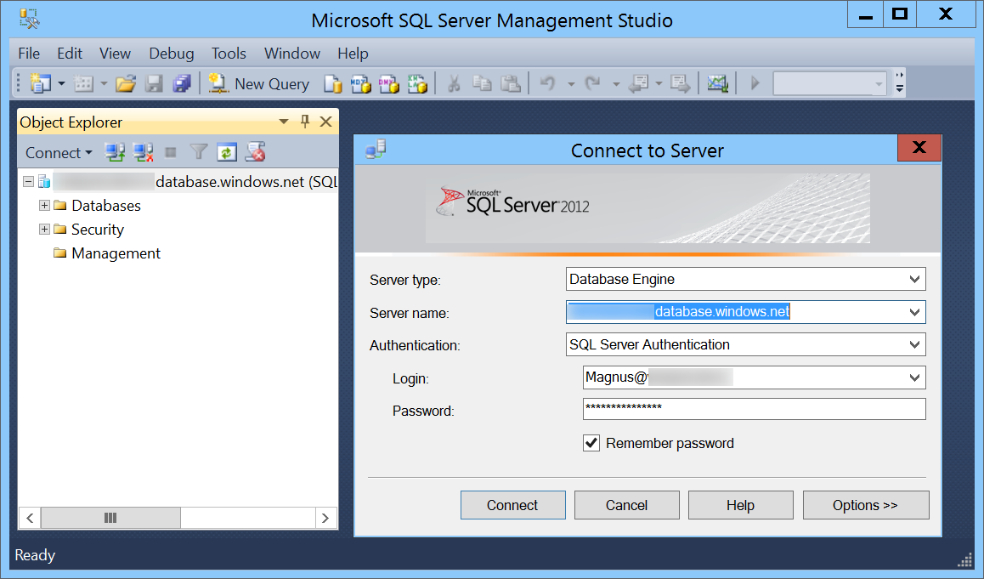
SQL Server Management Studio (SSMS)
Notes:
Slide Objectives:
Highlight the set of tools for developers when interacting with Microsoft Azure SQL Database.
Transition:
Transition statement(s) to setup the slide
Speaking Points:
SQL Database Management Portal -> Cross Browser, Unified Management Experience
SQL Server Data Tools -> Integrated Database Design Environment, Table Designer, Debugging, T-SQL Editor
Notes:
IntelliSense in T-SQL Editor
SQL Server Data Tools
Strive to make it consistent as possible
Intersection with the cloud
Bridging you to the new cloud world
Consistency to the new developer experience
Consistency with the new cloud model

Slide 40
DAC Deployment From SQL Server Management Studio
Demo
Notes:
Use SSMS to deploy DAC pack to previously provisioned database server

Slide 41
There are two ways to Secure a database
On The Server
Within The Database
Notes:
Slide Objectives:
Highlight the two areas where Microsoft Azure SQL Database can be secured.
Transition:
Security is vitally important and has not be overlooked. Microsoft Azure SQL Database takes security seriously.
Speaking Points:
Set security options on the server itself
Security within the database
Notes:
This doesn’t leave the application free of any responsibility…some settings are required to be set within the application.

Slide 42
SQL authentication supported
No Integrated authentication
The Admin login is similar to sa
Connect to master to administer logins
SQL Database Security On The Server
Notes:
Slide Objectives:
Highlight the important server security aspects and benefits of SQL Database security.
Transition:
From the server perspective, there are several things that should be things that should be considered when managing the security of your SQL Database.
Speaking Points:
No Integrated Authentication
Use Master to create and drop databases
The Admin login (which was created during server provisioning) is equivalent to sa. It has full rights on the server (and all databases) and should only be used for administration.
The loginmanager role is used for creating logins: membership in this role grants CREATE / ALTER / DROP Login privileges
The dbmanager role is used for creating databases: membership in this role grants CREATE / ALTER / DROP Database privileges
Manage logins with CREATE / ALTER / DROP LOGIN commands
Notes:
Although the server-level principal login is not a member of the two database roles dbmanager and loginmanager in the master database, it has all permissions granted to these two roles.

Slide 43
Logins require an associated user account
Admin login is automatically associated with dbo
The dbo has full rights in the database
SQL Database Security Within The Database
Notes:
Slide Objectives:
Highlight the important server security aspects and benefits of SQL Database security.
Transition:
From the server perspective, there are several things that should be things that should be considered when managing the security of your SQL Database.
Speaking Points:
No Integrated Authentication
Use Master to create and drop databases
The Admin login (which was created during server provisioning) is equivalent to sa. It has full rights on the server (and all databases) and should only be used for administration.
The loginmanager role is used for creating logins: membership in this role grants CREATE / ALTER / DROP Login privileges
The dbmanager role is used for creating databases: membership in this role grants CREATE / ALTER / DROP Database privileges
Manage logins with CREATE / ALTER / DROP LOGIN commands
Notes:
Although the server-level principal login is not a member of the two database roles dbmanager and loginmanager in the master database, it has all permissions granted to these two roles.

Slide 44
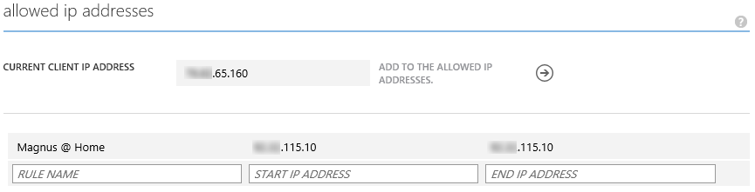
SQL Database Security with the Firewall
IP Address-based access control for SQL Database
Rules can be defined at the server and database
No IP authorized by default
Configurable using the SQL Database Portal and REST API
Option to disable/enable access from applications hosted in Microsoft Azure
Notes:
Slide Objectives:
Illustrate the how SQL Database Firewall
Transition:
Transition statement(s) to setup the slide
Speaking Points:
By default, no-one is allowed to access the database.
Server Rules enable clients to access your entire SQL Database server
Database rules enable clients to access individual databases within your SQL Database server
Rules are originating IP Address-based.
Notes:
Maximum of 128 Rules
Rather than using a REST API like the other Azure storage services, SQL Database is accessed via Tabular Data Stream (TDS), the same protocol used by Microsoft SQL Server (operating over port TCP/1433). To help protect the data, the SQL Database firewall prevents all access to your SQL Database server until you specify which computers have permission.
Initially, all access to your SQL Database server is blocked by the SQL Database firewall; connection attempts originating from the Internet or Microsoft Azure will not be able to reach your SQL Database server. In order to begin using your SQL Database server, you must go to the SQL Database Portal and specify one or more firewall settings that enable access to your SQL Database server. Use the firewall settings to specify which IP address ranges from the Internet are allowed, and whether or not Microsoft Azure applications can attempt to connect to your SQL Database server.

Slide 45
Connecting To SQL Database
The same way you’ve always done it!
<connectionStrings>
<add name="AdventureWorks"connectionString=
"Data Source= [server].database.windows.net;
Integrated Security=False;
Initial Catalog=ProductsDb;
User Id=[login]@[server];
Password=[password];
Trusted_Connection=False;
Encrypt=true;"
providerName="System.Data.SqlClient"/>
</connectionStrings>
Notes:
Slide Objectives:
Highlight application connectivity requirement, considerations and best practices to SQL Database.
Transition:
While connecting to SQL Database is fairly straight forward, there are some general considerations and recommended coding practices when developing Microsoft Azure SQL Database applications.
Speaking Points:
Login:
Idle connections terminated after 30 minutes
Long running transactions terminated after 24 hours
DoS guard terminates suspect connections with no error message
Failover events terminate connections
Throttling may generate errors…which leads to:
Implement Connection Pooling and Retry logic to handle transient failures
Latency introduced for updates due to HA replicas
No cross-database dependencies: resultsets from different database must be combined in the application tier (Fan out queries)
Notes:

Slide 46
SQL Database Considerations and Best Practices
login: [login]@[server]
Idle connections
Long running transactions
Notes:
Slide Objectives:
Highlight application connectivity requirement, considerations and best practices to SQL Database.
Transition:
While connecting to SQL Database is fairly straight forward, there are some general considerations and recommended coding practices when developing Microsoft Azure SQL Database applications.
Speaking Points:
Login:
Idle connections terminated after 30 minutes
Long running transactions terminated after 24 hours
DoS guard terminates suspect connections with no error message
Failover events terminate connections
Throttling may generate errors…which leads to:
Implement Connection Pooling and Retry logic to handle transient failures
Latency introduced for updates due to HA replicas
No cross-database dependencies: resultsets from different database must be combined in the application tier (Fan out queries)
Notes:

Slide 47
SQL Database Considerations and Best Practices
DoS guard
Failover events
Throttling
Notes:
Slide Objectives:
Highlight application connectivity requirement, considerations and best practices to SQL Database.
Transition:
While connecting to SQL Database is fairly straight forward, there are some general considerations and recommended coding practices when developing Microsoft Azure SQL Database applications.
Speaking Points:
Login:
Idle connections terminated after 30 minutes
Long running transactions terminated after 24 hours
DoS guard terminates suspect connections with no error message
Failover events terminate connections
Throttling may generate errors…which leads to:
Implement Connection Pooling and Retry logic to handle transient failures
Latency introduced for updates due to HA replicas
No cross-database dependencies: resultsets from different database must be combined in the application tier (Fan out queries)
Notes:

Slide 48
SQL Database Considerations and Best Practices
Connection pooling and Retry logic
Latency introduced for updates
No cross-database dependencies
Notes:
Slide Objectives:
Highlight application connectivity requirement, considerations and best practices to SQL Database.
Transition:
While connecting to SQL Database is fairly straight forward, there are some general considerations and recommended coding practices when developing Microsoft Azure SQL Database applications.
Speaking Points:
Login:
Idle connections terminated after 30 minutes
Long running transactions terminated after 24 hours
DoS guard terminates suspect connections with no error message
Failover events terminate connections
Throttling may generate errors…which leads to:
Implement Connection Pooling and Retry logic to handle transient failures
Latency introduced for updates due to HA replicas
No cross-database dependencies: resultsets from different database must be combined in the application tier (Fan out queries)
Notes:

Slide 49
Elastic Scale
Notes:
This section is optional. If you have an audience with a specific interest in this there are many more slides hidden in a section at the end!

Slide 50
Canonical cloud app architecture
Classic 3-tier enterprise architecture:
Scale out the front ends to multiple instances is easy
Scale the data-tier is more challenging
Notes:
Classic 3-tier enterprise architecture
Requires to scale to 10000s users and process TBs of relational data
Scaling out (and in, elastically) web and worker tiers is relatively easy
How to scale data-tier if hard limits of the biggest scale unit (e.g. P3 instance) are reached: both storage size and throughput?

Slide 51
SQL Database Considerations and Best Practices
Elastic Scale across thousands of databases via custom sharding
Scale out via .Net Client libraries consumed by customer applications to support sharded database pattern
Enables developer and manageability functions
Supports split, merge, and move operations on data

Slide 52
Scalability options in Azure SQL DB
Vertical: Scale-up or scale-down
Horizontal: Scale-out or scale-in
Premium
Premium
Standard
Standard
Scale up/down
Basic
Basic
Basic
Basic
Basic
Basic
Basic
Scale out/in
Notes:
Vertical: Change service-tiers for a given database as capacity needs fluctuate
Horizontal: Add or remove databases as more or less capacity is needed

Slide 53
Microsoft Azure Data Platform
SQL Database
SQL on IaaS
DocumentDB
Search
HDInsight
MongoDB, MySQL, Oracle, Cassandra, Neo4j and more
Notes:
Now let’s focus on SQL Server in a Microsoft Azure Virtual Machine!

Slide 54
Microsoft SQL Server on a Virtual Machine
SQL IaaS

Slide 55
Run SQL on VM
Run any SQL product on cloud VM
Support for SQL Server, Oracle, MySql
Ready to go VM images available in Gallery
Persistent storage using attached disk in blob storage
Has all the benefits and powers of VMs combined with the full features of a SQL Engine

Slide 56
Standing up a SQL Server in Azure using Marketplace
Demo
Notes:
Use portal.azure.com.
Enter Marketplace.
Select Data -> SQL Server -> Any SQL VM you like.
Show Pricing tier options and settings.
Deploy it!

Slide 57
Microsoft Azure Data Platform
SQL Database
SQL on IaaS
DocumentDB
Search
HDInsight
MongoDB, MySQL, Oracle, Cassandra, Neo4j and more
Notes:
There are other SQL Solutions you can choose to run in Azure. Official support exists for MySQL and Oracle.
(Good place to show the portal and that you can provision Oracle and MySQL databases in Azure just as easily as you can provision the Microsoft SQL options.

Slide 58
Microsoft Azure Data Platform
SQL Database
SQL on IaaS
DocumentDB
Search
HDInsight
MongoDB, MySQL, Oracle, Cassandra, Neo4j and more
Notes:
Time for the Microsoft Azure Search as a Service offering!

Slide 59
Azure Search

Slide 60
Why are we talking about Search?
Users find search as a natural, low friction way to interact with applications that manage lots of data
Web search engines have set the bar high for search
Search is hard and rarely a core expertise area

Slide 61
Azure Search
A fully managed search solution that allows developers to enable search experiences in applications.

Slide 62
Azure Search
Embed a sophisticated search experience into web and mobile applications without having to worry about the complexities of full-text search and without having to deploy, maintain or manage any infrastructure.

Slide 63
Azure Search
Perfect for enterprise cloud developers, cloud software vendors, cloud architects who need a fully-managed search solution.

Slide 64
Search Functionality
Simple HTTP/JSON API for creating indexes, pushing documents, searching
Keyword search with user-friendly operators (+, -, *, “”, etc.)
Hit highlighting
Faceting (histograms over ranges, typically used in catalog browsing)

Slide 65
Search Functionality
Suggestions (auto-complete)
Rich structured queries (filter, select, sort) that combines with search
Scoring profiles to model search result relevance
Geo-spatial support integrated in filtering, sorting and ranking

Slide 66
What does Azure Search cost?
Pricing Principles
Capacity Units are combinable
Search units stack horizontally and vertically
Key features
Simple API, keyword search with user-friendly operators, hit highlighting, faceting, suggestions, scoring profiles, geo-spatial
STANDARD OFFER
15MM documents
25GB database storage
15queries per second
$250.00/month
(discounted
50% for Preview)
Replicas (more queries, more HA)
Partitions
(more documents, more storage)
*Document count and throughput based on benchmark index and queries.

Slide 67
Business Plan
Customers buy one or more “search units”
Users control availability-cost trade-off by using more or less replicas
A search unit has specific capacity*
Document count – 15MM
Storage size – 25GB
Query performance – 15QPS
Search units stack horizontally and vertically
Must be a rectangular arrangement
Price: $250 per unit (at GA) per month
This is cost competitive
Free Tier for a sandbox environment
*Based on average index and average query.
Replicas (more queries, more HA)
Partitions
(more documents, more storage)

Slide 68
Azure Search walkthrough
Demo
Notes:
Use Azure Portal (Ibiza) to create a new database server

Slide 69
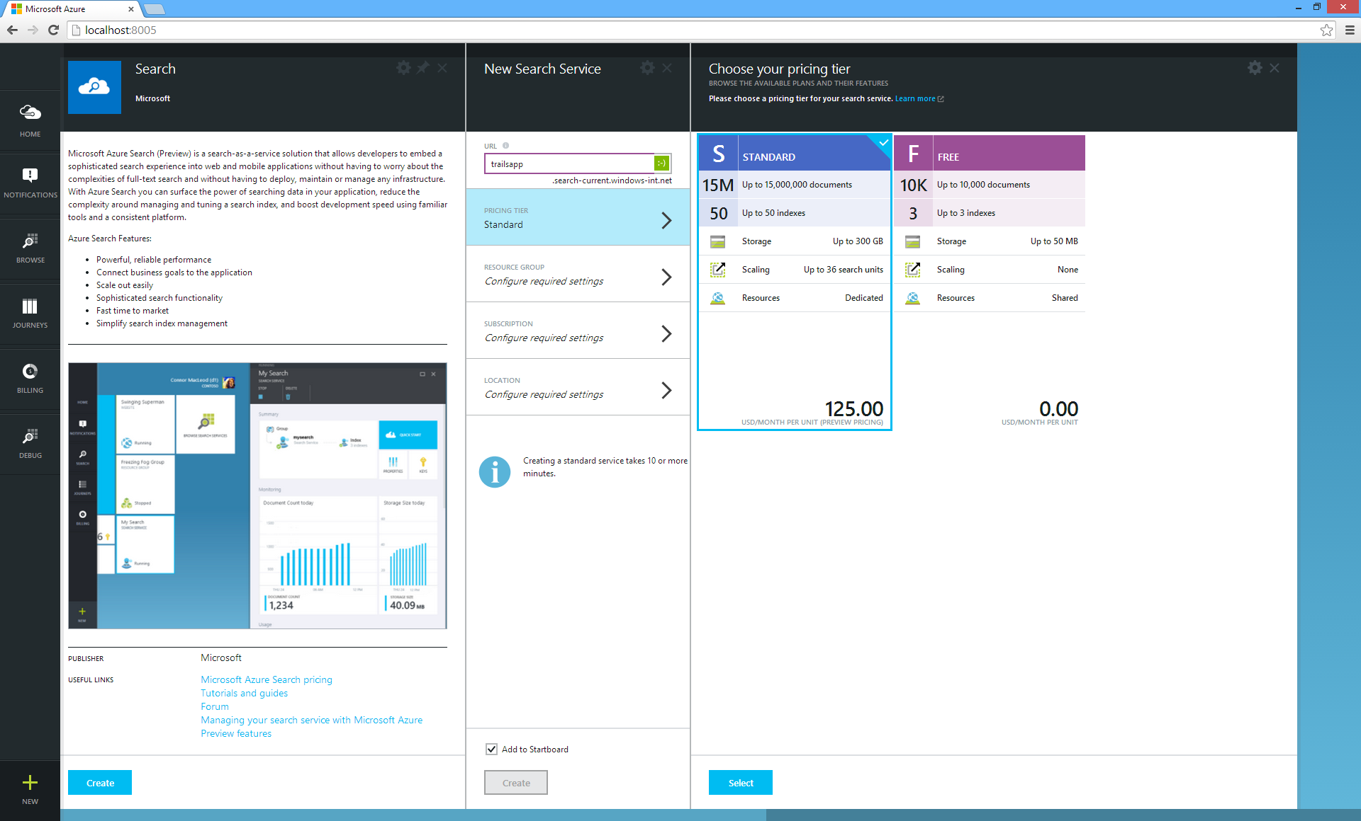
Choose Tier

Slide 70
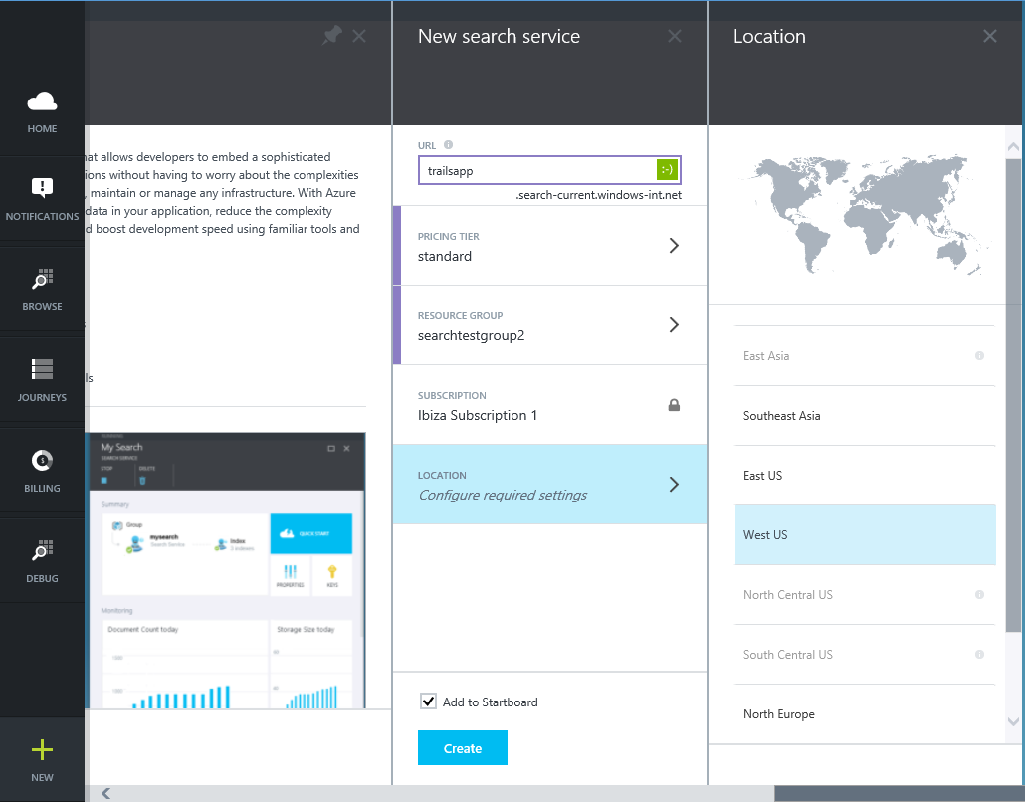
Global Availability

Slide 71
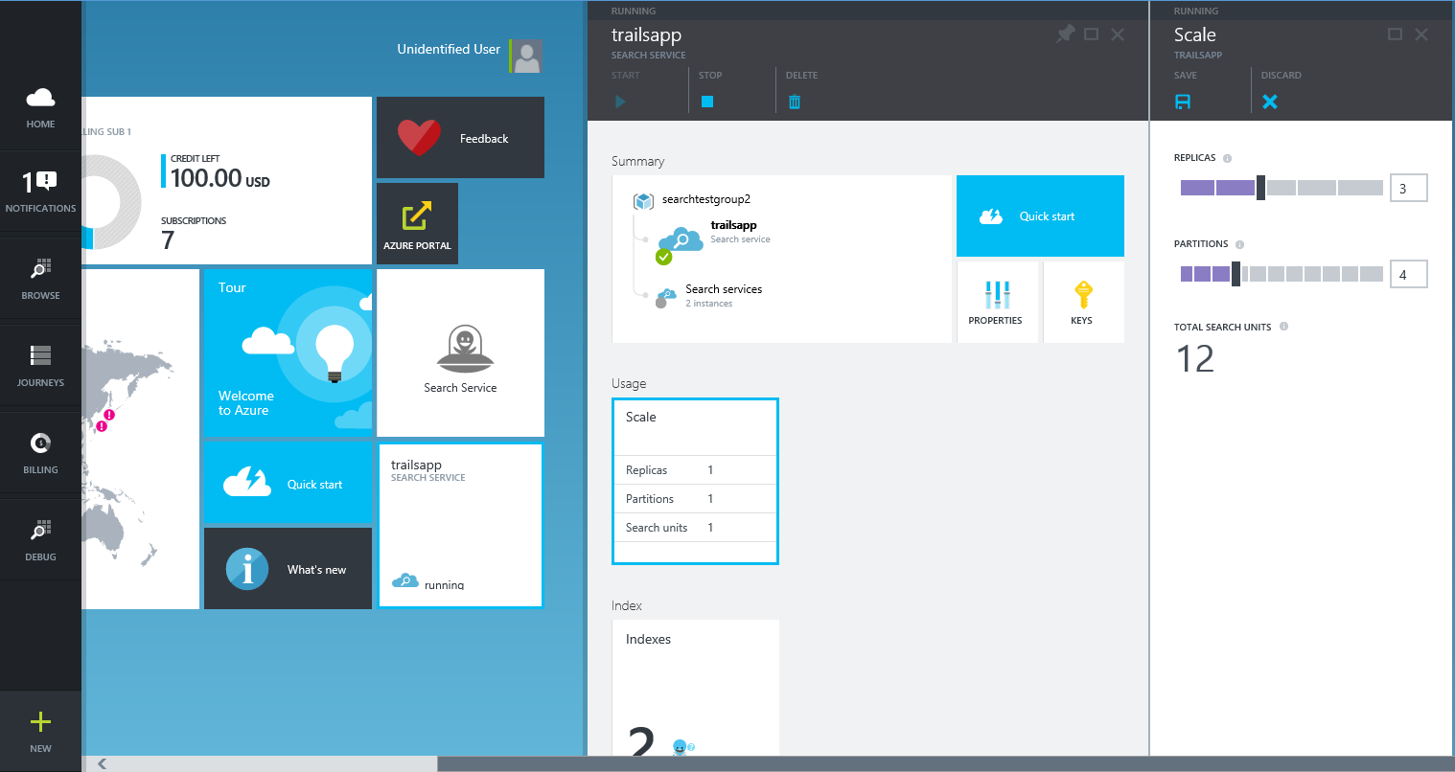
Scale Up

Slide 72
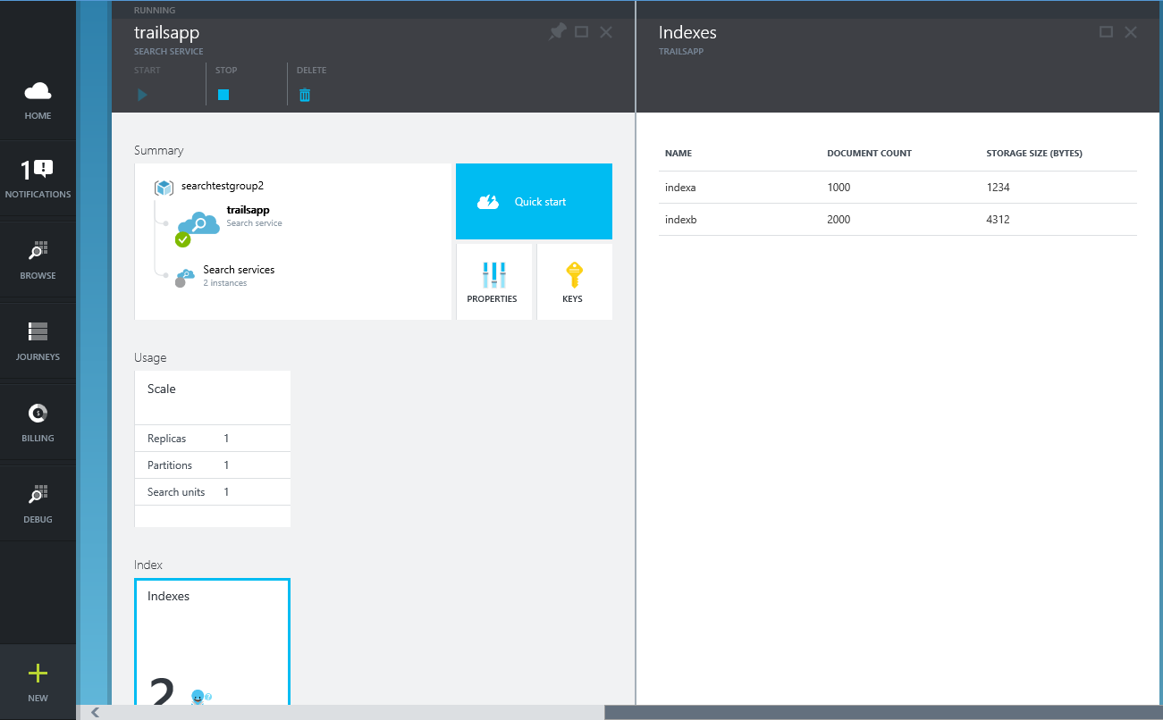
Manage Indexes

Slide 73
NoSQL

Slide 74
NoSQL is generally more scalable
The storage engines of NoSQL stores are designed to minimize contentions enabling higher throughput and therefore more scalable
Lower transaction capability in NoSQL results in less contention and therefore more scalable
Less complex query processor means that a single query can’t degrade service
Built-in replication capability means that store can scale out which better aligns to other application tiers (e.g. websites)
No fixed schema or lower schema requirements

Slide 75
NoSQL on Azure
Azure Table Service is a “Big Table” entity store
MongoDB and DocumentDb are document (JSON) stores
Cassandra is a columnar store with excellent replication
HBase is a Big Data (Hadoop) store available in HDInsight

Slide 76
Microsoft Azure Data Platform
SQL Database
SQL on IaaS
DocumentDB
Search
HDInsight
MongoDB, MySQL, Oracle, Cassandra, Neo4j and more
Notes:
Now let’s focus on the relatively new Microsoft Azure DocumentDB Service!

Slide 77
Microsoft Azure DocumentDB

Slide 78
Fully managed, scalable JSON document database service

Slide 79


Microsoft Azure Data Services
SQL Server in a VM
SQL Database
Tables
Blobs
fully featured RDBMS
transactional processing
rich query
managed as a service
elastic scale
schema-free data model
internet accessible http/rest
arbitrary data formats

Slide 80
Microsoft Azure Data Services
SQL Server in a VM
SQL Database
DocumentDB
Tables
Blobs
fully managed, scalable, queryable, schemafree JSON document database service for modern applications
fully featured RDBMS
transactional processing
rich query
managed as a service
elastic scale
schema-free data model
internet accessible http/rest
arbitrary data formats

Slide 81
Microsoft Azure Data Platform
SQL Database
SQL on IaaS
DocumentDB
Search
HDInsight
MongoDB, MySQL, Oracle, Cassandra, Neo4j and more
Notes:
There are many other storage solutions you can run in Azure. One such is MongdoDB which has been possible to run as a document database in Azure for a long time. How does it compare with DocumentDB?

Slide 82
Mongo in a VM
Existing applications which require extra capacity for scale out and can not be migrated
Customer has ecosystem of IT resources for support and maintenance
Removing CAPEX
Mongo MMS compatibility
DocumentDB
Applications that need managed elastic scale, query over schema free data, native JSON/JavaScript support
Customer does not want to add additional IT resources for support and maintenance
Avoiding CAPEX and OPEX
Built-for-the-cloud database technology

Slide 83
Strong Bounded Stateless Session Eventual
Tunable Consistency – four distinct levels
Notes:
Configurable consistency to trade off consistency and performance.
Database Accounts are configured with a default consistency level.
Consistency level can be weakened per read/query request.

Slide 84
All writes are visible to all readers. Writes synchronously committed by a majority quorum of replicas and reads are acknowledged by the majority read quorum.
Tunable Consistency – Strong

Slide 85
Guaranteed ordering of writes, reads adhere to minimum freshness. Writes are propagated asynchronously, reads are acknowledged by majority quorum lagging by at most K prefixes.
Tunable Consistency – Bounded Stateless

Slide 86
Read your own writes. Writes are propagated asynchronously while reads for a session are issued against the replica that can serve the requested version.
Tunable Consistency – Session

Slide 87
Reads eventually converge with writes. Writes are propagated asynchronously while reads can be acknowledged by any replica. Readers may view older data then previously observed.
Tunable Consistency – Eventual

Slide 88
Tunable Consistency
 | Writes | Reads
Strong | sync quorum writes | quorum reads
Bounded | async replication | quorum reads
Session* | async replication | session bound replica
Eventual | async replication | any replica
* | Ideal consistency and performance tradeoff for many application scenarios. High performance writes and reads with predictable consistency.

Slide 89
Pricing
Pricing Principles
Capacity Units are combinable
Storage, request units/second, and price scale linearly
provisioned capacity units
STANDARD OFFER for Preview
10GB database storage^{1,2}
2000Request units per second
$22.50/month
(discounted
50% for Preview)
throughput
Request units per second
db storage
GB
Attached BLOB storage not included in db storage.
Storage is inclusive of document data and indexes; we will provide guidance on limits for other DB entities.
Notes:
Before we get into the detail of how unique and transformative DocDB is, I’d like to point out that we have made buying and scaling the service very simple.
You buy DocDB in units. Each unit has 10GB of storage and 2000 request units per second. Think of request units as a form of currency where each request to the system has a cost and you get 2000 of these per second. Some examples of costs are:
Reading a single document
2000 reads
Inserting/Replacing/Deleting a single document
500 inserts/replace/deletes
Query a collection with a simple predicate and returning a single document
1333 queries
Stored Procedure a 50 document inserts
1000 inserts
Your database is automatically replicated to provide high availability. When you need more storage or more throughput, you just buy another unit. You then have twice as much storage and twice as many requests per second. DocumentDB storage and throughput scales linearly with cost. There is virtually no limit to the size of the database that it can scale to, although for Preview, we are limiting it to 5 units per database account. If you have a customer that needs more, just get in touch and we can remove that limit.

Slide 90
Request Units
Request units are provisioned for each database account based on the number of capacity units purchased.
Request unit consumption is evaluated as a rate per second.
Applications that exceed the provisioned request unit rate for their account will be throttled until the rate drops below the reserved level for the Account.
If your application requires a higher level of throughput, you can purchase additional capacity units.
Database Operations | Operations per second per capacity unit
Reading a single document | 2000 reads
Inserting/Replacing/Deleting a single document | 500 inserts/replace/deletes
Query a collection with a simple predicate and returning a single document | 1000 queries
Stored Procedure a 50 document inserts | 20 stored procedures

Slide 91
Microsoft Azure Data Platform
SQL Database
SQL on IaaS
DocumentDB
Search
HDInsight
MongoDB, MySQL, Oracle, Cassandra, Neo4j and more
Notes:
Now let’s focus on Hadoop in Azure known as Microsoft Azure HDInsight!

Slide 92
HDInsight

Slide 93
Big Data – Key trends
Device Explosion
Social Networks
>5.5 billion (70+% of global population)
>2 billion
users
Ubiquitous Connection
Sensor Networks
Web traffic
2010 130 exabyte (10 E18)
2015 1.6 zettabyte (10 E21)
>10 billion

Slide 94
Big Data – Key trends
$100 gets you 3 million times more storage in 30 years
1980 10 MIPS/$
2005 10 million MIPS/$
Cheap Storage
Inexpensive Computing

Slide 95


Characteristics of Big Data
New Data Sources
Large Data Volumes
New Technologies
Non-traditional Data Types
New Economics
New Questions & New Insights

Slide 96
Traditional E-Commerce Data Flow
OPERATIONAL DATA
NEW USER REGISTRY
NEW PURCHASE
NEW PRODUCT
Data Warehouse
ETL Some Data
Logs
Excess Data

Slide 97
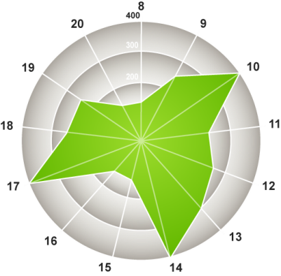
New E-Commerce Data Flow
OPERATIONAL DATA
NEW USER REGISTRY
NEW PURCHASE
NEW PRODUCT
Logs
Data Warehouse
Raw Data “Store it All” Cluster
Logs
How much do views for certain products increase when our TV ads run?

Slide 98
RDBMS vs. Hadoop
Data size | Gigabytes (Terabytes) | Petabytes (Hexabytes)
Access | Interactive and Batch | Batch
Updates | Read / Write many times | Write once, Read many times
Structure | Static Schema | Dynamic Schema
Integrity | High (ACID) | Low
Scaling | Nonlinear | Linear
Reference: Tom White’s Hadoop: The Definitive Guide

Slide 99
Programming HDInsight – Existing ecosystem
Hive
Pig
Mahout
Cascading
Scalding
Scoobi
Pegasus
…

Slide 100
Programming HDInsight – Microsoft .NET
C#
F#
Map/Reduce
Microsoft .NET management clients

Slide 101
Programming HDInsight – DevOps / IT Pros
PowerShell
Cross-Platform CLI tools (xplat-cli)

Slide 103
Microsoft Azure SQL Database
Notes:
SQL Database extras!

Slide 104
SQL Database Service
A relational database-as-a-service, fully managed by Microsoft.
For cloud-designed apps when near-zero administration and enterprise-grade capabilities are key.
Perfect for cloud architects and developers looking for programmatic DBA-like functionality.
Elastic scale & performance
Business
continuity & data protection
Familiar & self-managed
Predictable performance levels
Programmatic scale-out
Dashboard views of DB metrics
Self-service restore
Disaster recovery
Compliance-enabled
Familiar tools
Programmatic
Self-managed

Slide 105
Introducing new service tiers
Basic
Standard
Premium (in preview)
Light transactional workloads
The go-to option for modern business apps
Mission-critical databases
Elastic scale & performance: Six performance levels across three tiers for scale up and down based on throughput needs. Better resource isolation Improved billing experience.
Business continuity: A spectrum of business continuity features from light-weight to mission-critical across the tiers. Customers can dial up the control over data recovery and failover.
Familiar & Self-managed: Unprecedented efficiencies as your applications scale with a near-zero maintenance service and a variety of familiar management tools & programmatic APIs.

Slide 106
Designed for predictable performance
Redefined
Across Basic, Standard, and Premium, each performance level is assigned a defined level of throughput
Measure of power
Introducing the Database Throughput Unit (DTU) which represents database power and replaces hardware specs
% CPU
DTU is defined by the bounding box for the resources required by a database workload and measures power across the six performance levels.
% read
% write
Basic — 5 DTU
S0 — 10 DTU
S1 — 20 DTU
S2 — 50 DTU
P1 — 100 DTU
P2 — 200 DTU
P3 — 800 DTU
% memory

Slide 107
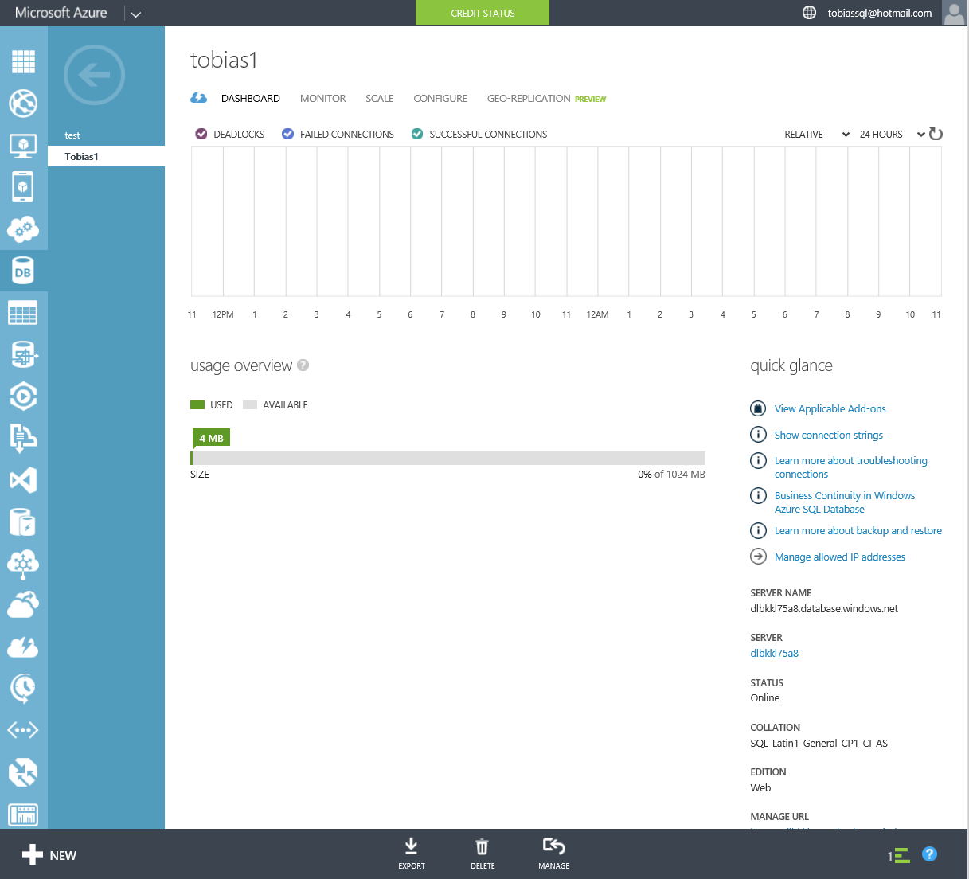
Dashboard views of metrics
Monitor
Quickly understand DB resource usage via percent of resources consumed for each resource type over time and database size
Available in the management portal & via APIs
In contrast to a VM, no system-related overhead—focused on just the resources used to run your database workload
In-depth views (DMVs) are also available for deeper understanding and trouble-shooting (for example, at the query level)

Slide 108
Self-managed
Built-in Maintenance
Remove virtually all infrastructure maintenance with SQL Database which provides automatic software patching as part of the service.
Fault tolerance
Built-in system replicas help deliver inherent data protection and database uptime. System replicas are automatically moved to new machines as old machines fail.

Slide 109
Programmatic
Dev Ops
Scale out or manage DBA-like functionality via programmatic APIs to support ongoing needs—REST & PowerShell
Platforms
Develop with a choice of popular platforms and technologies, including .NET, Java, PHP, Ruby on Rails, and Node.js.

Slide 110



Familiar
Tools
Choice of management tools; APIs, Azure Management Portal with HTML5 support, or SQL Server Management Studio.
Skills
Leverage SQL Server skills across on-premises and cloud environments with a familiar relational foundation and T-SQL functions, including spatial data support for location-based apps.
Flexible dev
Support seamless development on or offline and across on-premises and cloud-designed apps with Visual Studio. Extend existing applications to the cloud with DAC framework support.

Slide 111
SQL Database – investments this year
SLA
Increased from 99.9% to 99.99% uptime SLA
Performance
New service design point enables scale up of resources, delivering predictable throughput & performance
Protection
Point-in-time-restore, geo-restore, and standard and active geo-replication protect against human & environmental-initiated events
Compliance
Azure certifications: ISO, HIPAA BAA, EU Model Clause
Auditing on SQL Database
Flexibility
Increased max size from 150 GB to 500 GB
Moved from daily to hourly billing

Slide 112
Yes, but can it support terabytes of data?
With SQL Database scale out technology, hard limits are mitigated
SQL Database
scale up limits
DTU (throughput) currently up to 800 DTU or ~735 tx/second*
Max DB size (up to 500GB)
Customer dimensions to consider
Pure max data size
Active portion of total data
Amount of transactional workload the app will generate
Largest amount of data that needs to live in the same transactional space (i.e. database)
Scale out options
100 S2 for 5000 DTUs (max db size 25TB) ($90,000/12 months)
25 P2 for 5000 DTUs (max db size 12.5TB) ($279,000/12 months)
* Based on Azure SQL Database Benchmark estimation and specific OLTP workload configuration

Slide 113
Focus on logical vs. physical administration
Database and log files automatically placed
Three high-availability replicas maintained for every database
Tables require a clustered index
Maximum database size is 500 GB
Azure SQL Database vs. SQL Server
Notes:
Slide Objectives:
Point out that 1) The same great technologies that developers use today on-premises works with SQL Database 2) high-level differences between on-premises and SQL Database 3) SQL Database features currently unsupported
Transition:
Creating, managing, and deploying a database in Microsoft Azure SQL Database isn’t difficult. The key is understanding the features that are supported and how SQL Database compares to on-premises SQL Server and the technologies that can be used with SQL Database.
Speaking Points:
The same great technologies that developers use today on-premises works with SQL Database, including developer languages, Frameworks, and Tools. Nothing new to learn!
SQL Server Comparison -> highlight the physical vs. logical administration. Developers and DBAs can now focus on things they love to do and not worry about the physical aspect.
Features unsupported by SQL Database -> Many of the unsupported features are hardware based and thus don’t need to be in SQL Database. Other features, such as encryption, are server-based and become a challenge in solving in a shared-environment.
Notes:
CLR data types ARE supported, SQLCLR is not yet supported.
Backup/Restore: PIT Coming; Import/Export can be used for backup to BLOB storage. Third-party backup products available via RedGate and Enzo.
Data can be stored encrypted but the encryption must be done at the application level.
Native encryption is being looked at.
**Linked Servers and Distributed Queries are now supported, linking a SQL Database instance from an on-premises server. Linking two SQL Database instances is NOT supported.

Slide 114
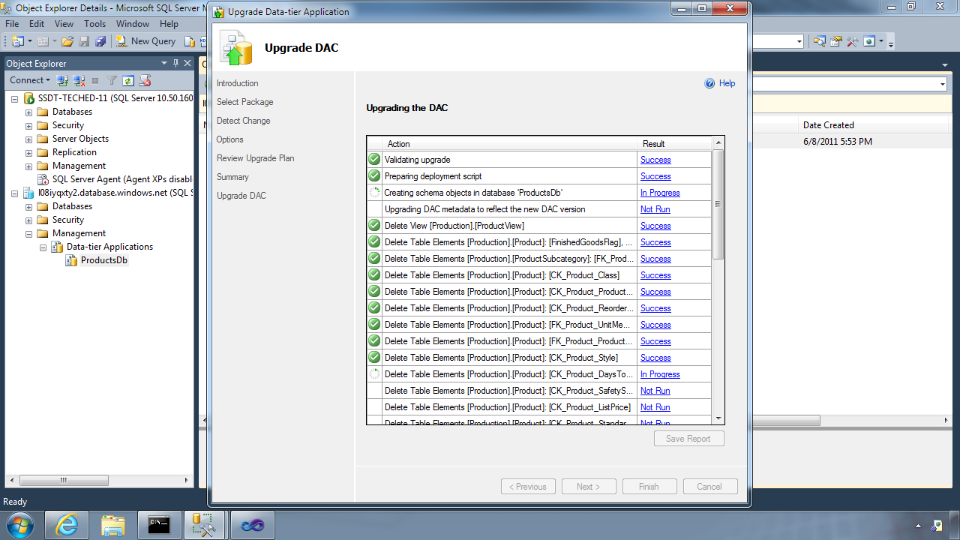
Database Deployment - Data-Tier Application Framework (DAC Fx)
Alternative to traditional script based approach
Dramatically simplifies deployment, migration and versioning of databases
Provides a single unit of deployment for schema (dacpac) or for schema + data (bacpac)
Supports automatic versioning of database schemas
Supports platform targeting for both SQL Server (2005 and above) and SQL Database
Build from scratch or extract from existing db
Notes:
Slide Objectives:
Discuss the deployment options for migrating your on-premises database to SQL Database.
Transition:
There are many ways to migrate your on-premises SQL Server database to Microsoft Azure SQL Database, but there have been great enhancements and improvements in both DAC and SSDT to dramatically improve and simplify deployment and migration options.
Speaking Points:
DAC Framework – A new unit of deployment called a bacpac which contains both schema AND data.
SQL Server Data Tools – Easily determine “Azure read” status. Provide single Publish capability.
Notes:
Both DAC and SSDT provide instant feedback as to the “azure-ready” status of your on-premises database. SSDT provides a single publish from source to destination, but DAC creates a deployment unit which can be stored in Azure storage or on-premises and used to create multiple SQL Database instances.

Slide 115
Database Deployment - How To Get The Latest DAC Fx
SQL Server Data Tools
SQL Server 2012/2014 Management Studio
SQL Database Import/Export Service
http://sqldacexamples.codeplex.com
Notes:
Slide Objectives:
Discuss the deployment options for migrating your on-premises database to SQL Database.
Transition:
There are many ways to migrate your on-premises SQL Server database to Microsoft Azure SQL Database, but there have been great enhancements and improvements in both DAC and SSDT to dramatically improve and simplify deployment and migration options.
Speaking Points:
DAC Framework – A new unit of deployment called a bacpac which contains both schema AND data.
SQL Server Data Tools – Easily determine “Azure read” status. Provide single Publish capability.
Notes:
Both DAC and SSDT provide instant feedback as to the “azure-ready” status of your on-premises database. SSDT provides a single publish from source to destination, but DAC creates a deployment unit which can be stored in Azure storage or on-premises and used to create multiple SQL Database instances.

Slide 116
loginmanager role: Server-Level security role for creating logins
dbmanager role: Server-Level security role for creating databases
SQL Database Server Security
Notes:
Slide Objectives:
Highlight the important server security aspects and benefits of SQL Database security.
Transition:
From the server perspective, there are several things that should be things that should be considered when managing the security of your SQL Database.
Speaking Points:
No Integrated Authentication
Use Master to create and drop databases
The Admin login (which was created during server provisioning) is equivalent to sa. It has full rights on the server (and all databases) and should only be used for administration.
The loginmanager role is used for creating logins: membership in this role grants CREATE / ALTER / DROP Login privileges
The dbmanager role is used for creating databases: membership in this role grants CREATE / ALTER / DROP Database privileges
Manage logins with CREATE / ALTER / DROP LOGIN commands
Notes:
Although the server-level principal login is not a member of the two database roles dbmanager and loginmanager in the master database, it has all permissions granted to these two roles.

Slide 117
Manage users with CREATE / ALTER / DROP USER commands
Add users to roles via sp_add_rolemember to grant privileges
Utilize schemas where appropriate
SQL Database Security
Notes:
Slide Objectives:
Highlight the important server security aspects and benefits of SQL Database security.
Transition:
From the server perspective, there are several things that should be things that should be considered when managing the security of your SQL Database.
Speaking Points:
No Integrated Authentication
Use Master to create and drop databases
The Admin login (which was created during server provisioning) is equivalent to sa. It has full rights on the server (and all databases) and should only be used for administration.
The loginmanager role is used for creating logins: membership in this role grants CREATE / ALTER / DROP Login privileges
The dbmanager role is used for creating databases: membership in this role grants CREATE / ALTER / DROP Database privileges
Manage logins with CREATE / ALTER / DROP LOGIN commands
Notes:
Although the server-level principal login is not a member of the two database roles dbmanager and loginmanager in the master database, it has all permissions granted to these two roles.

Slide 118
Connecting To SQL Database
Tabular Data Stream (TDS) protocol over TCP/IP
SSL required
<connectionStrings>
<addname="AdventureWorks"connectionString=
"Data Source=[server].database.windows.net;
Integrated Security=False;
Initial Catalog=ProductsDb;
User Id=[login]@[server];
Password=[password];
Trusted_Connection=False;
Encrypt=true;"
providerName="System.Data.SqlClient"/>
</connectionStrings>
Notes:
Slide Objectives:
Highlight application connectivity requirement, considerations and best practices to SQL Database.
Transition:
While connecting to SQL Database is fairly straight forward, there are some general considerations and recommended coding practices when developing Microsoft Azure SQL Database applications.
Speaking Points:
Login:
Idle connections terminated after 30 minutes
Long running transactions terminated after 24 hours
DoS guard terminates suspect connections with no error message
Failover events terminate connections
Throttling may generate errors…which leads to:
Implement Connection Pooling and Retry logic to handle transient failures
Latency introduced for updates due to HA replicas
No cross-database dependencies: resultsets from different database must be combined in the application tier (Fan out queries)
Notes:

Slide 119
Elastic Scale
Notes:
Extra Elastic Scale slides!

Slide 120
When is Elastic Scale the right consideration?
Application workload can be partitioned across a number of scale units, and workload directed to each partition can fit into the biggest scale unit available
Application workload doesn’t contain large scans or aggregations that need to touch the entire data set
Total capacity demands (CPU, IO, memory, storage) of the application exceed the hard limits of a single Azure SQL Database scale unit
Application requires on-demand or automatic policy-driven scale out or scale in
Caveat: Typical data warehousing does not easily fit the patterns for Elastic Scale

Slide 121
Scalability = Capacity * Density
Adding more Capacity
Using Capacity more Efficiently
Identifying and breaking contention and choke points
How to add additional capacity to a solution?
There are subtle constraints to consider...
Traditional performance tuning
Maximize application throughput (e.g leveraging batching)
Improving network performance

Slide 122
Common database scalability patterns
Single large database
Fabrikam
Inventory
Order
Vertically partitioned
Invoice
1 tenant: 1 DB (ISV/CSV)
Root
Cust. #2
Cust. #n
Cust. #1
Other partitioning scheme
Root
Shard #1
Shard #2
Shard #n

Slide 123
How to peel apart customer requirements
Customer example: 9 TB data | 5000 tx*/sec | 100GB largest shard
SQL Database
scale up limits
DTU (throughput) currently up to 800 DTU or ~735 tx/second*
Max DB size (up to 500GB)
Customer dimensions to consider
Pure max data size
Active portion of total data
Amount of transactional workload the app will generate
Largest amount of data that needs to live in the same transactional space (i.e. database)
Scale out options
100 S2 for 5000 DTUs (max db size 25TB) ($90,000/12 months)
25 P2 for 5000 DTUs (max db size 12.5TB) ($279,000/12 months)**
* Based on Azure SQL Database Benchmark estimation
** Will provide additional Business Continuity features

Slide 124
Multi-Tenant SaaS
Central directory where customer profiles are stored
One database per end customer (tenant)
Often for security and isolation
Some rely on schema customization
Data dependent routing is common data access path
Highly selective key lookup queries, multi-joins, etc.
Mid to low data entry rate
No need for cross-customers (fan-out) queries
Most tenants are small and “cold”, some may have hot spots
Optimizing COGS by picking the right Service Tier for the customer (mostly Basic)
Example
MYOB
Sage

Slide 125
Continuous data collection
Sensor and Telemetry Processing
Large data ingestion workloads
Mostly append only (Cola bottling analogy)
Two options, depending on application query patterns
Querying ranges of last X days of data (e.g. trend analysis)
Randomly extracting data from the entire database (e.g. lookup a certain Jan event)
Typically requires fan-out queries
App
App
reads
reads
reads
writes
reads/writes
reads/writes
reads
reads/writes
reads/writes
Jan
Feb
Mar
Oct
Nov
#1
#2
#3
…..
#N
…
…
Time
Scale

Slide 126
High Scale OLTP
Large, (mostly) uniform, active data set
Distribute partition-able tables across as many shards as necessary
See Appendix for shards (scale units) capacity planning
Some shards can become way more active than others
Pinning hot users to dedicated databases
Move users to balance workload between databases
Scale to the proper Service Tier (Premium) to deal with increased workload
Split-merge actions are required to fully exploit elasticity
Mostly data dependent routing with key lookup queries
Few fan-out queries may be required (e.g. leaderboards, inventory management, etc.)
Examples
Pottermore

Slide 127
Sharding and Tenancy Models
Single tenant per database
Each tenant’s data is stored in a different database
Better isolation of tenants as compared to multi-tenant model
Multiple tenants per database
Multiple tenants share the same database
Less isolation of tenants as compared to single tenant model
Typically more cost-effective than the single tenant model
Hybrid model
Some tenants share databases, others get their own database
E.g., premium or paying customers get their own databases, while free tier customers share databases
Temporal model
Sharding based on date/time
Most recent shard is constantly loaded with newly arriving data
New shards added when current most recent shard nears capacity

Slide 128



Elastic Scale: Overview
Elastic Scale app
Cross-Shard Capabilities
Elastic Scale
Manage-ability
Client library
Cross-shard extensions
Cross-shard
operations
Cross-shard
operations
Application
Developer
Admin/
DevOps
shard₁
shard_{i}
shard_{j}
shard_{n}
Client library
Shard-local
operations
Shard-local
operations
…
…
…
Grow/shrink capacity
Admin/
DevOps

Slide 129
Elastic Scale: Key Capabilities
Client .NET APIs
Management Services
Shard map management (SMM)
Define groups of shards for your application
Manage mapping of routing keys to shards
Data dependent routing (DDR)
Route incoming requests to the correct shard, e.g., given a customer ID
Ensure correct routing as tenants move
Cache routing information for efficiency
Multi-shard query (MSQ)
Interactive processing across several shards
Same statement executed on all shards with UNION all semantics
Shard Set Execution (SSE)
Interactive processing across several shards
Same statement executed on all shards with UNION all semantics
Split/Merge (SM)
Grow or shrink capacity by adding or removing scale units
Dynamically adjust scale factor of scale unit
Trigger adjustment dynamically through policies
Shard Elasticity (SE)
Dynamically adjust scale factor of scale unit
Trigger adjustment dynamically through policies

Slide 130
Elastic Scale Overview
Two types of shard maps
Range: contiguous values
List: explicit values
Four types of sharding keys
INT, BIGINT, GUID, VARBINARY
[shardmaps_global]
smid | name
1 | RangeShardMap
[shards_global]
sid | smid | Datasource | Databasename
1 | 1 | serverName | DB2
2 | 1 | serverName | DB2
[shard_mappings_global]
mid | smid | min | max | Sid
1 | 1 | 0 | 100 | 1
2 | 1 | 100 | 200 | 2
Shard Map Manager
DB₁
_{[0-100)}
DB₂
_{[100-200)}
DB₃
_{[200-300)}
DB₄
_{[300-400)}
DB₅
_{[400-500)}
DB₅
_{[500-600)}
DB_{n}
_{[n-n+100)}
. . .
Shard Set

Slide 131


Elastic Scale Overview
Two classes of operations:
Individual shards
Cross shards
Two Personas:
Application Developer
Admin/DevOps
.NET Client Api
Customer Hosted Services
Application
Developer
Admin/
DevOps
Query a specific shard
Query multiple shards
Capacity, cost mgmt.
DB Maintenance, DDL
DB₁
_{[0-100)}
DB₂
_{[100-200)}
DB₃
_{[200-300)}
DB₄
_{[300-400)}
DB₅
_{[400-500)}
DB₅
_{[500-600)}
DB_{n}
_{[n-n+100)}
. . .

Slide 132
Data Dependent Routing (DDR)
Scenario: query a shard with a specific shardlet key
Shard Map Manager
Client App
DDR APIs ( )
Application
Developer
Admin/
DevOps
SELECT *
FROM customers
WHERE customer ID = 104
DB₁
_{[0-100)}
DB₂
_{[100-200)}
DB₃
_{[200-300)}
DB₄
_{[300-400)}
DB₅
_{[400-500)}
DB₅
_{[500-600)}
DB_{n}
_{[n-n+100)}
. . .

Slide 133
Data Dependent Routing (DDR)
// Get a routed connection for a given shardingKey
using (SqlConnection conn = ShardMap.OpenConnectionForKey(
shardingKey,
connectionString /* Credentials Only */ ,
ConnectionOptions.Validate /* Validate */ ));
{
using (SqlCommand cmd = new SqlCommand()
{
cmd.Connection = conn;
cmd.CommandText = "SELECT dbNameField, TestIntField, TestBigIntField FROM ShardedTable";
SqlDataReader sdr = cmd.ExecuteReader();
// Now consume results from the data reader…
}
}

Slide 134
Data Dependent Routing (DDR)
Caching: improve performance of shard operations
Global Shard Map (GSM) – state of all shards in the Shard Map
Local Shard Map (LSM) – state of all shards on a particular shard
Client Cache (eager/lazy) – state of all shards in the Shard Map/known shards
Shard Map Manager
Client App
DDR APIs ( )
Application
Developer
GSM
Cache
DB₁
_{[0-100)}
LSM

Slide 135
Multi-shard Query (MSQ)
Scenario: execute a query across a set of shards (returns a UNION ALL result set)
Shard Map Manager
Client App
MSQ APIs ( )
Application
Developer
Admin/
DevOps
SELECT count(*)
FROM customers
UNION ALL result set
DB₁
_{[0-100)}
DB₂
_{[100-200)}
DB₃
_{[200-300)}
DB₄
_{[300-400)}
DB₅
_{[400-500)}
DB₅
_{[500-600)}
DB_{n}
_{[n-n+100)}
. . .

Slide 136
Multi-shard Query (MSQ)
using (MultiShardConnection conn = new MultiShardConnection(m_shardMap.GetAllShards(null), MultiShardTestUtils.GetTestSqlCredential()))
{
using (MultiShardCommand cmd = conn.CreateCommand())
{
cmd.CommandText = "SELECT dbNameField, TestIntField, TestBigIntField FROM ShardedTable";
cmd.CommandType = CommandType.Text;
cmd.Policy = MultiShardPolicy.PartialResults;
using (MultiShardDataReader sdr = cmd.ExecuteReader(includeShardNameColumn: true))
{
while (sdr.Read())
{
var dbNameField = sdr.GetString(0);
var testIntField = sdr.GetFieldValue<int>(1);
var testBigIntField = sdr.GetFieldValue<Int64>(2);
string shardIdPseudoColumn = sdr.GetFieldValue<string>(3);
}
}
}
}

Slide 137
Shard Set Executer (SSE)
Scenario: perform an admin action across of set of shards
Customer Hosted Services
(SSE)
Application
Developer
Admin/
DevOps
CREATE TABLE foo (col1 INT)
DB₁
_{[0-100)}
DB₂
_{[100-200)}
DB₃
_{[200-300)}
DB₄
_{[300-400)}
DB₅
_{[400-500)}
DB₅
_{[500-600)}
DB_{n}
_{[n-n+100)}
. . .

Slide 138
Split/Merge (SM)
Scenario: perform a split or merge action
Split: create two distinct shards from one
Merge: create one shard from two distinct shards
Customer Hosted Services
(SM)
Application
Developer
Admin/
DevOps
Merge
Split
DB₁
_{[0-100)}
DB₂
_{[100-200)}
DB₃
_{[200-300)}
DB₄
_{[300-400)}
DB₅
_{[400-500)}
DB₅
_{[500-600)}
DB_{n}
_{[n-n+100)}
. . .
DB_{2.1}
_{[100-300)}
DB_{5.1}
_{[400-450)}
DB_{5.2}
_{[450-500)}

Slide 139
Shard Elasticity (SE)
Scenario: automation to vertically scale a shard or horizontally scale a shardset
Vertical scale: increase/decrease the performance level of the shard
Horizontal scale: add/remove a shard to the shard set
Azure Automation (SE)
Application
Developer
Admin/
DevOps
Vertical scaling
DB₅
_{[500-600)}
DB₅
_{[400-500)}
DB₄
_{[300-400)}
Horizontal scaling
DB₁
_{[0-100)}
DB₂
_{[100-200)}
DB₃
_{[200-300)}
DB_{n}
_{[n-n+100)}
. . .
Basic
Basic
Basic
S2
P1
P3
time

Slide 140
References
Client library and service packages are available on Nuget.org
Search for ‘Elastic Scale’ to find the projects on Nuget.org
Search for ‘Elastic Scale’ in the VS Package Manager to find the DLL
Client library: http://www.nuget.org/packages/Microsoft.Azure.SqlDatabase.ElasticScale.Client/
Split/Merge: http://www.nuget.org/packages/Microsoft.Azure.SqlDatabase.ElasticScale.Service.SplitMerge/
Documentation on Azure.com in the SQL Database section
Search for ‘elastic scale documentation map azure.com’
Get stared: http://azure.microsoft.com/en-us/documentation/articles/sql-database-elastic-scale-get-started/
Documentation map: http://azure.microsoft.com/en-us/documentation/articles/sql-database-elastic-scale-documentation-map/
Samples in the VS code samples gallery
Search for ‘Elastic Scale’ on https://code.msdn.microsoft.com/
Search for ‘Elastic Scale’ in the Online Samples section for new VS projects

Slide 141

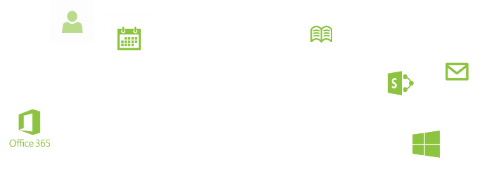
Elastic Scale Recap
Support key large scenarios at scale in Azure SQL Database
High-volume OLTP
Continuous data collection
Multi-tenant SaaS
Elastic Scale offers built-in technology
Transparency at the app tier through Elastic Scale APIs
Azure cloud service templates to manage Elastic Scale app at runtime
Key workloads can now scale freely in Azure SQL Database
Elastic resources and capacity
No longer limited to a single database or its hard limits
Match aggregate capacity of all shard to overall capacity
needs of the app

Slide 142
Azure Search
Notes:
Extra Azure Search slides!

Slide 143
Search Overview
1 of 4
A fully-managed search solution that allows developers to enable search experiences in applications.
Embed a sophisticated search experience into web and mobile applications without having to worry about the complexities of full-text search and without having to deploy, maintain or manage any infrastructure.
Perfect for enterprise cloud developers, cloud software vendors, cloud architects who need a fully-managed search solution.
Surface Your Data
Reduce Complexity
Move Quickly with Confidence
Powerful, guaranteed performance
Sophisticated search
Connects business goals to the application
Simplify search index management
Scale-out easily
Fast time to market
Backed by Microsoft Azure
Release Timing
Public Preview: August 21, 2014
GA: 4-6 Months after Preview

Slide 144

Why?
Why?
Users find search as a natural, low friction way to interact with applications that manage lots of data
Web search engines have set the bar high for search
Instant results, auto-complete, hit highlighting, great ranking, linguistics
Search is hard and rarely a core expertise area
From infrastructure standpoint: availability, durability, scale, operations
From the functionality standpoint: ranking, geo-spatial, input handling
Target Scenarios
Ecommerce, Online retail
User generated content, social applications
Line-of-business applications

Slide 145
Why are we talking about Search?
Users find search as a natural, low friction way to interact with applications that manage lots of data
Web search engines have set the bar high for search
Instant results, auto-complete, hit highlighting, great ranking, linguistics
Search is hard and rarely a core expertise area
From infrastructure standpoint: availability, durability, scale, operations
From the functionality standpoint: ranking, geo-spatial, input handling

Slide 146
What are the search technology options?
Manually Managed
Apache Lucene
Apache SOLR (based on Lucene)
Elasticsearch (based on Lucene)
SharePoint Search
Endeca
SLI
Google Commerce Search
and others…
Search-as-a-Service
AWS CloudSearch
Searchify
LucidWorks
Azure Search
Google App Engine Search
Algolia
and others…
or
=

Slide 147
What about SharePoint Search?
SharePoint 2013 provides enterprise grade search functionality and an extensive connector eco-system for IW/Productivity scenarios
Customer Strategy
IT utilizing SharePoint and/or O365 deployment (hybrid) needing Enterprise search
Unified search across Intranet/Extranet/LOB, 3rd party CMS, Fileshares, etc..
SharePoint Search
Needs search-as-a-service for building apps and services
Azure Search
SharePoint Search
Moving on-premises search (most commonly Lucene) to the cloud
Azure Search
Scenarios: New Cloud E-commerce, User generated content, LOB Apps outside the firewall
Azure Search

Slide 148

What are customers doing with Azure Search?
high
high heels
high tops
high arch

Slide 149
Scenario Examples
Ecommerce, Online retail
“Major Online Retailer”
Full product catalogue
Hundreds of queries per second
Constant updates
Seasonal ranking and scale
User generated content, social applications
“Consumer-facing photo sharing site”
Geo-spatial search
High document volume
High indexing rate
Line-of-business applications
“Customer relationship management application”
High incoming indexing
High document count
Structured, heterogeneous data

Slide 150
Experience Walk Through
Initial service provisioning in Azure portal

Slide 151
Appendix: Experience Walk Through
Using APIs for creating and populating indexes

Slide 152
Defining Indexes
A search service can contain one or more indexes
An index is a container of documents and the scope for queries
Index definitions include
Fields, including their data types and search capabilities to enable
E.g. searchable, filterable, sortable, facetable, source for suggestions
Access options (e.g. CORS)
Zero or more scoring profiles
POST /indexes HTTP/1.1
{
"name": "trails",
"fields": [
{ "name": "name", "type": "Edm.String",
"suggestions": true, "filterable": false },
{ "name": "class", "type": "Edm.String" },
{ "name": "tags", "type": “Collection(Edm.String)“,
"suggestions": true, “facetable": true },
{ "name": "location", "type": "Edm.GeographyPoint" },
{ "name": "elevation", "type": "Edm.Int32" },
"searchable": false },
{ "name": "dateCreated", "type": "Edm.DateTime" },
{ "name": "rating", "type": "Edm.Int32" }
],
"corsOptions": {
"allowedOrigins": ["*"]
}
}

Slide 153
Indexing Data
Data is loaded into the index using the indexing API
Can be done in batches
Up to 1000 operations per batch
Mix of upserts, merges, deletes
Changes to indexes reflected in near-real time
5-30 seconds typical index-to-searchable latency
POST /indexes/trails/index HTTP/1.1
{
"items": [
{
"action": "upload",
"key": "1502914",
"data": {
"name": "Penny Creek",
"class": "Stream",
"tags": ["Easy", "Scenic"],
"location": {
"type": "Point",
"coordinates": [
-123.5357095,
46.5526032
]
},
"elevation": 61,
"dateCreated": "1992-12-31T01:00:00Z",
"rating": 1
}
},
{ … }, { … }
]
}

Slide 154
Appendix: Experience Walk Through
Searching

Slide 155
Searching
Search API takes options in URLs and returns JSON results
Simple keyword search:
http://.../indexes/trails/search?search=rattlesnake creek
Using prefix and phrase search:
http://.../indexes/trails/search?search=eas* "rattlesnake creek"
Search combined with structured filter and projection:
http://.../indexes/trails/search?search=eas* "rattlesnake creek“&$filter=class eq ‘Trail‘ or class eq 'Lake‘&$select=name,location,rating

Slide 156
Searching (continued)
Search combined with distance-based filter (locations under 10 KM from reference point):
http://.../indexes/trails/search?search=eas* "rattlesnake creek“&$filter=geo.distance(location, geography'POINT(-122.131577 47.678581)') le 10
Enable hit-highlighting, faceting:
http://.../indexes/trails/search?search=rattlesnake creek&highlight=name,tags&facet=tags&facet=rating,sort:value
Use a scoring profile
http://.../indexes/trails/search?search=rattlesnake creek&scoringProfile=holidaysSeasson

Slide 157
Controlling Relevance
"scoringProfiles": [
{
"name": "sp",
"text": {
"weights": {
"county": 2, "class": 2
}
},
"functions": [
{
"type": "magnitude",
"boost": 3,
"fieldName": "rating",
"interpolation": "linear",
"magnitude": {
"boostingRangeStart": 1,
"boostingRangeEnd": 5
}
},
{
"type": "distance",
"boost": 15,
"fieldName": "location",
"interpolation": "quadratic",
"distance": {
"referencePointParameter": "loc",
"boostingDistance": 250
}
}
]
}
]
Scoring profiles capture relevance without mixing it with queries
A profile is made of one or more scoring functions
Can also include field weights
Scoring functions for most typical requirements
Magnitude, freshness, distance
An interpolation mode can be selected for each usage of each function
Final score factors in text statistics, field weights and functions

Slide 158
Microsoft Azure DocumentDB
Notes:
Extra DocumentDB slides

Slide 159

DocumentDB Overview
A NoSQL document database-as-a-service, fully managed by Microsoft Azure.
For cloud-designed apps when query over schema-free data; reliable and predictable performance; and rapid development are key. First of its kind database service to offer native support for JavaScript, SQL query and transactions over schema-free JSON documents.
Perfect for cloud architects and developers who need an enterprise-ready NoSQL document database.
Rich Query and Transactions
over Schema-free Data
Reliable &
Predictable Performance
Rapid Development
Query schema-free data with no secondary indices
Native JavaScript transactional processing
Familiar SQL-based query language
Fast, predictable performance
Tunable consistency
Elastic scale
Build with familiar tools – REST, JSON, JavaScript
Easy to start and fully-managed
Enterprise-grade Azure platform
Release Timing
Public Preview: August 21, 2014
GA: H2 FY15

Slide 160
Proven @ Scale
Data store powering production Microsoft services.
Scale tested with databases over 10TBs of JSON document data from Office OneNote API service
Rapidly evolving data models and query patterns based on 3rd party applications
Serving over 1 million active users
Operating consistently with 99.95% availability
First Party Use Cases
Store, roam and query user generated data across applications
Extensible data models for 3rd party integration
Social activity and awareness feeds with views and filtering

Slide 161
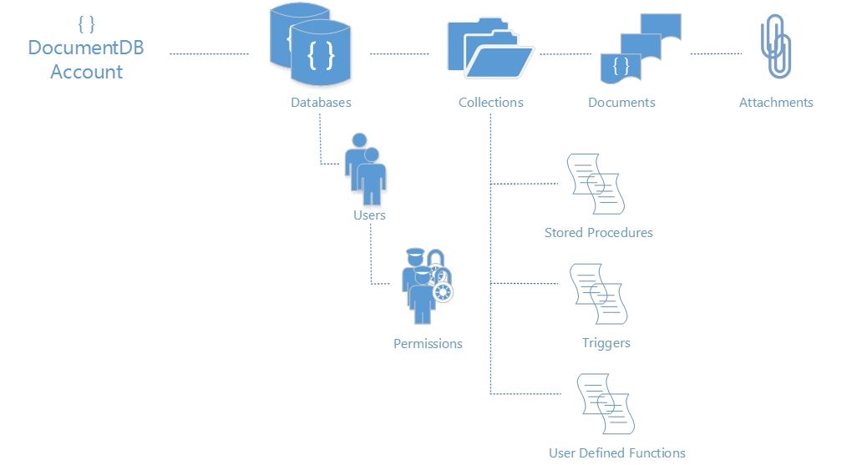
Microsoft Azure DocumentDB
{ “topic” : “resource model”}
Resource Model
Simple HTTP RESTful programming model.
All entities uniquely addressable by a logical URI.
Standard HTTP verbs and semantics – PUT, POST, PATCH, DELETE, GET, HEAD
Partitioned for scale out and replicated for HA
Granular access control through item level permissions
Attachments stored in Azure Blobs and follow document lifecycle
DocumentDB accounts scale out through the addition of capacity units with associated DB storage and throughput
https://myaccountname.documents.azure.net/dbs/{id}/colls/{id}/docs/{id}
/dbs/{id}
/colls/{id}
/docs/{id}
/attachments/{id}
/users/{id}
/sprocs/{id}
/triggers/{id}
/functions/{id}

Slide 162
Interaction Model
RESTful interaction model over HTTP (and TCP)
Database access methods exposed using standard HTTP verbs & semantics
Stateless interaction with built-in rate limiting and retry
Interact using your favorite HTTP client
Designed for Gateway as well as, Direct Connectivity options
Resource
POST
Tenant
Resource set
Insert
Resource
PUT
Resource
Replace
DELETE
Resource
POST http://myaccount.documents.azure.net/dbs
{ “id":"My Company Db"}
...
[201 Created]
{
“id": "My Company Db",
“_rid": "UoEi5w==",
“_self": "dbs/UoEi5w==/",
“_colls": "colls/",
“_users": "users/"
}
Delete
GET
Tenant
Resource set
Enumerate
SQL
POST
Tenant
Documents
Query
args
POST
Tenant
sproc results
Execute

Slide 163
LINQ Query
Query
// book.Title lookup against automatic server index
from book in client.CreateDocumentQuery<Book>(collectionSelfLink)
where book.Title == "War and Peace" select book;
// Nested book.Author.Name also indexed!
from book in client.CreateDocumentQuery<Book>(collectionSelfLink)
where book.Author.Name == "Leo Tolstoy"
select book.Author;
// Array lookups
from book in client.CreateDocumentQuery<Book>(collectionSelfLink)
where book.Languages.Any(lng => (lng.Name == "English"))
select book;
Query over heterogeneous documents without defining schema or managing indexes
Query arbitrary paths, properties and values without specifying secondary indexes or indexing hints
Execute queries with consistent results in the face of sustained writes
Query through fluent language integration including LINQ for .NET developers and a “document oriented“ SQL grammar for traditional SQL developers
Extend query execution through application supplied JavaScript UDFs
Supported SQL features at Preview; predicates, iterations (arrays), sub-queries, logical operators, UDFs, intra-document JOINs, JSON transforms
SQL Query Grammar
-- Nested lookup against index
SELECT B.Author
FROM Books B
WHERE B.Author.Name = "Leo Tolstoy"
-- Transformation, Filters, Array access
SELECT { Name: B.Title, Author: B.Author.Name }
FROM Books B
WHERE B.Price > 10 AND B.Language[0] = "English"
-- Joins, User Defined Functions (UDF)
SELECT CalculateRegionalTax(B.Price, "USA", "WA")
FROM Books B
JOIN L IN B.Languages
WHERE L.Language = "Russian"
The “write” index for consistent queries
highly concurrent, lock free, log structured indexing technology developed with Microsoft Research
Optimized for SSD (works well for HDD)
Resource governed for tenant isolation

Slide 164
Transactions and JavaScript App Logic
Familiar Programming Model
Stored Procedures
Triggers
UDFs
Language Integrated transactions
JavaScript as a modern day T-SQL
The entire procedure is wrapped in an implicit ACID transaction
JavaScript throw statement results into aborting the transaction
Pre-compiled on registration
Resource Governed & Sandboxed
No imports are allowed
Eval() is disallowed
Execution is time boxed
Governed for CPU, IO and memory
Stored Procedures
client.executeStoredProcedureAsync ("procs/1234", "MasterChief", "SolidSnake") .then(function (response) { console.log(“success!"); }, function (err) { console.log("Failed to swap!", error); });
function(playerId1, playerId2) { var collection = getContext().getCollection();
var playersToSwap = collection.filterDocuments(function (document) { return (document.id == playerId1 || document.id == playerId2); });
var player1 = playersToSwap[0], player2 = playersToSwap[1]; var player1ItemTemp = player1.item; player1.item = player2.item; player2.item = player1ItemTemp;
collection.replaceDocument(player1) .then(function() { return collection.replaceDocument(player2); }) .fail(function(error){ throw 'Unable to update players, abort'; }); }

Slide 165
Programmability
client = new DocumentClient(new Uri(endpointUrl), authKey);
Database database = await client.CreateDatabaseAsync(new Database{Id = “myNewDatabase”});
DocumentCollection collection = await client.CreateDocumentCollectionAsync(database.SelfLink, new DocumentCollection{Id = “Pages"});
Page page = new Page
{
Id = "Sample",
Title = "About Paris",
Language = new Language { Name = "English" },
Author = new Author { Name = "Don” },
Content = "Don's document in DocDB is a valid JSON document",
PageViews = 10000,
Topics = new Topic[] {
new Topic { Title = "History" },
new Topic { Title = "Places to see" }}
};
ResourceResponse<Document> resp = await client.CreateDocumentAsync(collection.DocumentsLink, page);
Broad language and platform support
REST/HTTP APIs
C#, Node.js, JavaScript and Python SDKs for Public Preview
SDKs open sourced through GitHub
C# Client SDK
Supports gateway and direct connectivity
Async APIs for all operations
HTTP and TCP transports available
POCOs, inherited document types and dynamics
LINQ provider for query execution

Slide 166
HDInsight
Notes:
Extra HDInsight slides!

Slide 167


Big Data analytics
Data
acquisition
& modeling
Collaboration
& visualization
Analysis & data mining
Dissemination, sharing, preservation
It takes more time to hand a project from the seismic guys to me to the engineers in production than it does to figure out the oil field plays.
Geologist, Major oil and gas company
Our weather model and resulting data sets should be accessible to universities and other institutions.
Aerospace Development Manager, U.S. Federal Government

Slide 168
What is Big Data?
Internet of Things
Social Sentiment
Exabytes
(10e18)
Click Stream
Sensors / RFID / Devices
Wikis / Blogs
Modern Web
Audio / Video
Mobile
Petabytes
(10e15)
Log Files
Advertising
eCommerce
Collaboration
Spatial & GPS Coordinates
Volume
ERP / CRM
Digital Marketing
Data Market Feeds
Terabytes
(10e12)
Search Marketing
Payables
Contacts
eGov Feeds
Payroll
Deal Tracking
Web Logs
Weather
Gigabytes
(10e9)
Inventory
Sales Pipeline
Recommendations
Text/Image
Velocity | Variety | Variability
ERP / CRM
Modern Web
Internet of Things

Slide 169
Building developer experiences
Authoring Jobs
App Integration
End-user tooling (IDEs, analyst tools, Command lines)
Extend breadth & depth
Enable new scenarios
Integrate with current tool chains
Lightweight
Low cost to extend
Scenario oriented
Breadth of clients (Java, JS, Microsoft .NET)
Consistent REST APIs
Connectivity
Programmability
Security
Loosely coupled
Innovation flows upward
New compute models
Performance enhancements
Core Hadoop
Authoring frameworks and languages

Slide 170
Demo - HDInsight
Notes:
Provision a cluster via Portal
Provision a cluster via Powershell

Slide 171

Hadoop Architecture
Task tracker
Task tracker
MapReduce Layer
Job tracker
Name node
HDFS Layer
Data node
Data node
Reference: http://en.wikipedia.org/wiki/File:Hadoop_1.png
Notes:
,

Slide 172

Hadoop ecosystem
Pipeline / workflow
(Oozie)
Graph
(Pegasus)
Stats processing
(RHadoop)
Machine Learning
(Mahout)
Data Integration
( ODBC / SQOOP/ REST)
Metadata
(HCatalog)
Legend
■ Core Hadoop
■ Data processing
■ Data Movement
■ Packages
NoSQL Database
(HBase)
Scripting
(Pig)
Query
(Hive)
Distributed Processing
(MapReduce)
Distributed Storage
(HDFS)

Slide 173
HDInsight and Hadoop
ODBC
C#, F#, .NET
Sqoop for SQL Server
PowerShell
Hadoop Core +
Hive, Pig, HBase
Office 365 Power BI (Excel, PowerQuery, PowerView,
BI Sites)
Azure Storage (WASB)
World's Data (Azure Data Marketplace)

Slide 174
Detailed Offerings
INSIGHTS
Integration with Microsoft Power BI stack
Hive ODBC Driver
ENTERPRISE
READY
Hadoop distribution for Microsoft Azure
Strategic Partnership with Hortonworks
BROADER
ACCESS
Integration with diverse sources of data

Slide 175
Deploying and Interacting With a Hadoop Cluster on Azure

Slide 176
MapReduce
Analogous to GROUP BY in SQL
Usually combiners can be an effective way to minimize network IO
Based on the dataset opportunity to use a custom partitioner to balance the reducers
Complete control of mappers and reducers
Non-trivial to write

Slide 177
Hive
SQL-Like query syntax – if you know SQL, you’ll be able to use Hive
Relational set algebra mixed with row-oriented manipulation
Declare tables (internal and external) and views
Query processor optimizes MapReduce job
Microsoft Azure

Slide 178
HiveQL Examples
Create an External Table
CREATE EXTERNAL TABLE iislogs(
sdate string, stime string, ssitename string, csmethod string, csuristem string, csuriquery string, sport int, scstatus int, scbytes int, sbytes int, timetaken int)
ROW FORMAT DELIMITED
FIELDS TERMINATED BY ' '
LOCATION
'wasb://iis-logs@myapp.blob.core.windows.net/'
Run a query to return data
select sdate, stime, csmethod, scuristem, query_params['api-version'] as api_version, query_params['search_value'] as search_value
from (select *, str_to_map(csuriquery, '&', '=') as query_params
from iislogs
) version_logs
where query_params['api-version'] is not null

Slide 179
Pig
Script language for expressing MapReduce jobs
Script operations can be chained together
Compiler optimizes MapReduce job

Slide 180
PigLatin Examples
Load and Transform Data
A = load 'passwd' using PigStorage(':'); -- load the passwd file
B = foreach A generate $0 as id; -- extract the user IDs
store B into ‘id.out’; -- write the results to a file name id.out
Run a query to return and process data
LOGS = LOAD 'wasb:///example/data/sample.log';
LEVELS = foreach LOGS generate REGEX_EXTRACT($0, '(TRACE|DEBUG|INFO|WARN|ERROR|FATAL)', 1) as LOGLEVEL;
FILTEREDLEVELS = FILTER LEVELS by LOGLEVEL is not null;
GROUPEDLEVELS = GROUP FILTEREDLEVELS by LOGLEVEL;
FREQUENCIES = foreach GROUPEDLEVELS generate group as LOGLEVEL, COUNT(FILTEREDLEVELS.LOGLEVEL) as COUNT;
RESULT = order FREQUENCIES by COUNT desc;
DUMP RESULT;

Slide 181
Microsoft Big Data Roadmap
Microsoft is extending its leadership in business intelligence and data warehousing to provide insights to all users by activating new types of data of any size
To accelerate the delivery of Microsoft’s Hadoop based solution for Windows Server and service for Microsoft Azure, Microsoft is announcing a partnership with Hortonworks
Microsoft is announcing an end-to-end roadmap for Big Data that embraces Apache HadoopTM by distributing enterprise class Hadoop based solutions on both Windows Server and Microsoft Azure
Microsoft is committed to broadening accessibility and usage of Hadoop to end users, developers and IT professionals in organizations of all sizes

Slide 182
Resources
http://www.hadooponazure.com/
http://hadoop.apache.org/

Slide 183
16 regions worldwide in 2014
Azure footprint

Slide 184
>57%
Greater than
1,000,000
>250k
Fortune 500 using Azure
Active websites
SQL Databases in Azure
>20
>1
TRILLION storage objects
>300
MILLION
AD users
MILLION
Developers registered with Visual Studio Online
>2
MILLION requests/sec
>13
BILLION
authentication/wk

Slide 185


Slide 186

Get started
Visit azure.microsoft.com

Slide 187

SQL Database Billing Rates (As of February 2012)
Database Size | Price Per Database Per Month
0 to 100 MB | Flat $4.995
> 100 to 1 GB | Flat $9.99
> 1GB to 10 GB | $9.99 for first GB, $3.99 per additional GB
> 10 GB to 50 GB | $45.954 for first 10 GB, $1.998 for each additional GB
> 50 GB to 150 GB | $145.874 for first 50 GB, $0.999 for each additional GB
Based on graduated rate based on database size
Charged at monthly rate per database
Amortized over month -> calculated on daily basis
No Transaction Charges
Data Transfers
North America and Europe regions $0.05 - $0.12 per GB outbound
Asia Pacific region $0.12 - $0.19 per GB outbound
All inbound data transfers are at no charge.
Notes:
Slide Objectives:
Understand the SQL Database pricing
Transition:
Speaking Points:
Reduced database rates as of February 2012
Notes:
http://www.windowsazure.com/en-us/pricing/details/#data-management
http://www.windowsazure.com/en-us/pricing/details/#data-transfers

Slide 188
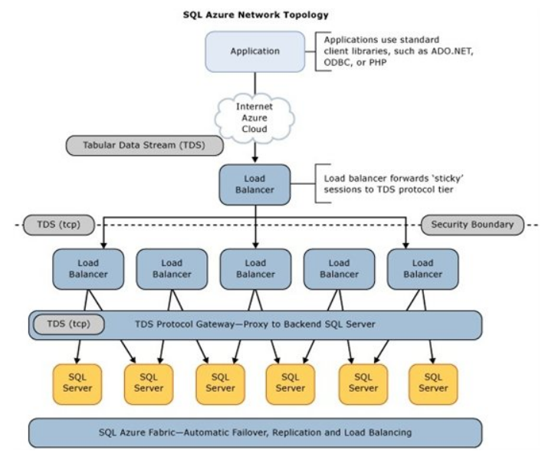
SQL Database Architecture

